Slide 2
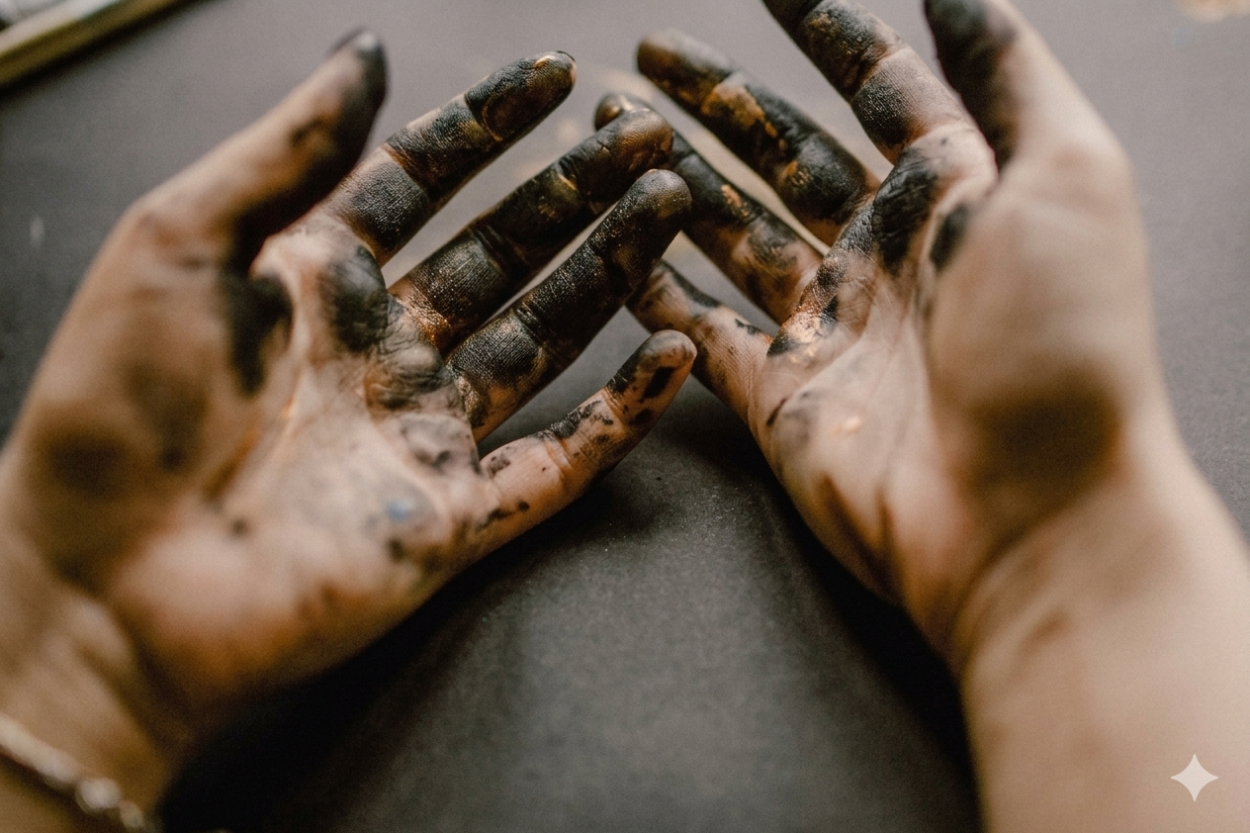
POLLUTION
Jeremiah 3:1-11

Slide 3

POLLUTION OF THE HEART
Proverbs 4:23
Mark 7:21-23
Jeremiah 17:9-10
Matthew 5:8
James 4:8
Psalm 51:10

Slide 4
POLLUTION OF THOUGHTS
Numbers 32:23
Matthew 5:29
Job 31:1
Titus 2:12
Philippians 4:8
Romans 12:2

Slide 5
POLLUTION OF MORALS
Titus 1:15-16
Ephesians 5:3
Daniel 1:8
Psalm 119:9

Slide 6
POLLUTION OF GOALS
2 Corinthians 5:9
Ephesians 5:8-10
Philippians 3:13-14
2 Corinthians 7:1
Deuteronomy 4:9
2 Peter 2:20-22

Slide 7
Do we fight the greatest
POLLUTION?
James 1:27
1 Timothy 1:5
Colossians 3:1-2
Spiritual Pollution Is Real!
Sin Is What Pollutes Us!
1 Corinthians 6:9-11

