Slide 2
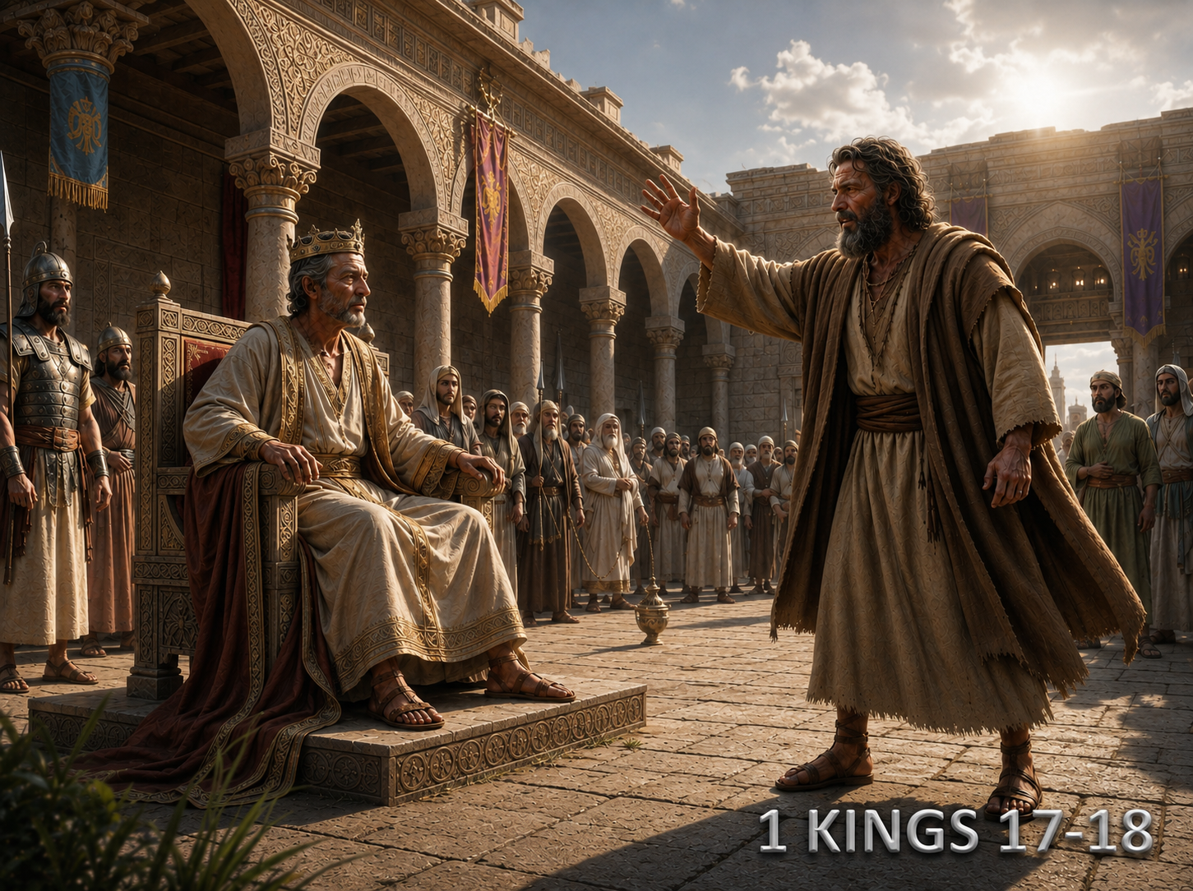
Lessons From Elijah

Slide 3
Faith to deliver
unwelcome message.
Deut. 11:16-17
Acts 4:19-20; 5:29
Confronting Sin.
(Eph. 4:5; Rom. 10:14; Gal. 6:1; James 5:19-20)
Drought affected everyone!
(2 Tim. 3:12)

Slide 4
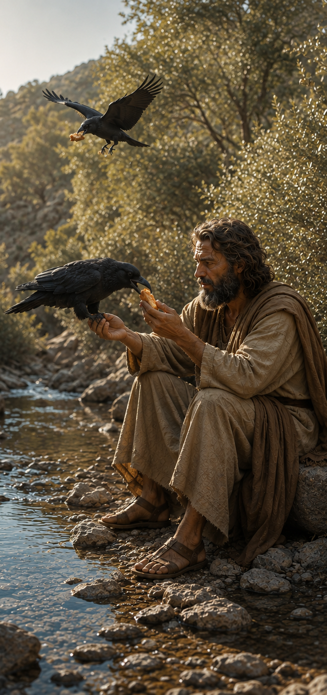
Rely On God!
1 Kings 17:2-3
1 Kings 17:8-16
1 Kings 17:22-24
We must rely and trust in God!
Matthew 6:31-33
Philippians 4:6-7

Slide 5
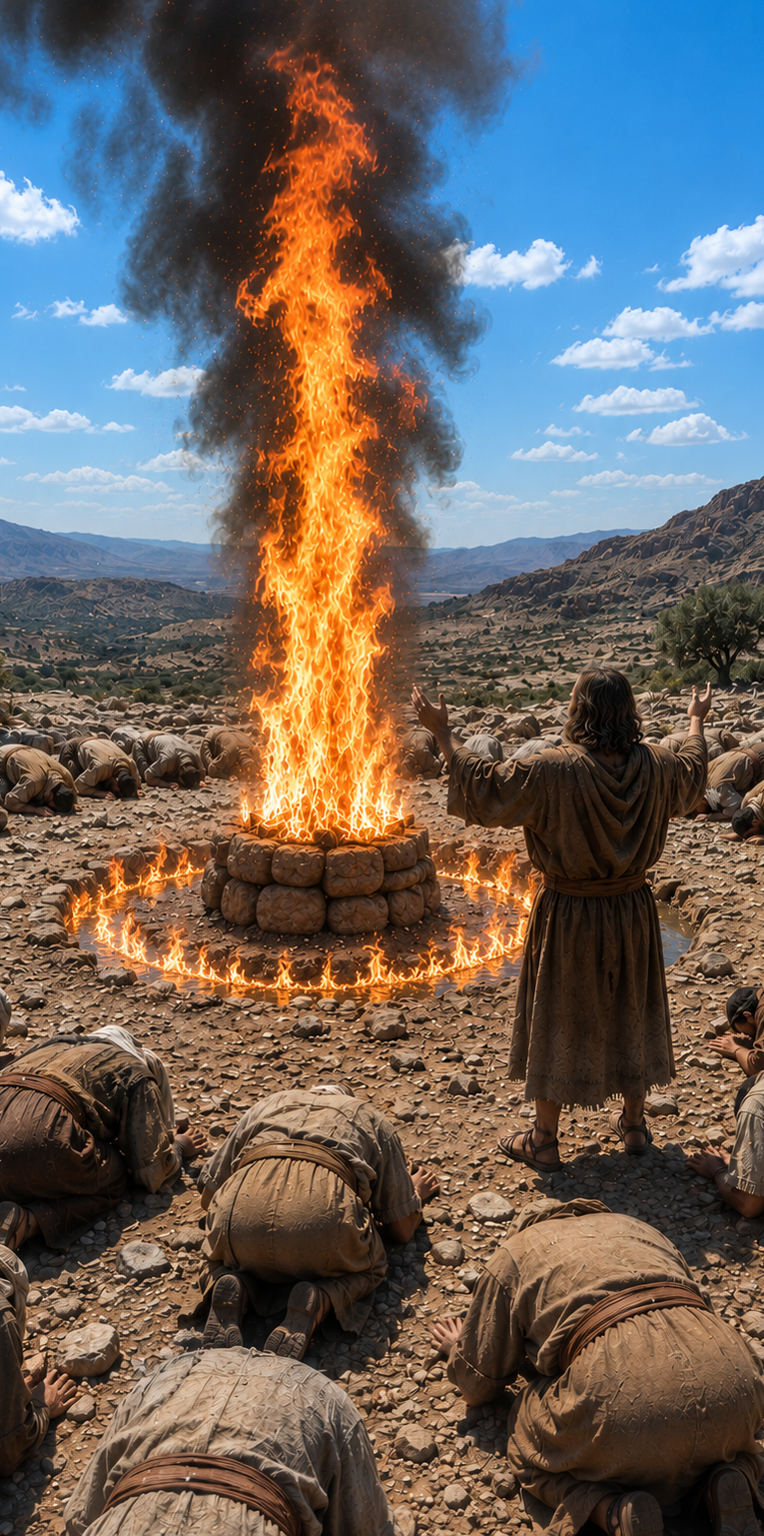
1 Kings 18:17-30
1 Kings 18:32-40
See Elijah’s faith!
With God is Victory!
(1 Sam. 14:6; Judges 7, 15
Rom. 8:31, 37)
Same for us!
1 Peter 3:12; 1 Cor. 15:57; 1 John 5:4; 2 Cor. 2:14; Rom .8:37

Slide 6
1 Corinthians 15:58
“Therefore, my beloved brethren, be steadfast, immovable, always abounding in the work of the Lord, knowing that your toil is not in vain in the Lord.”
Have we learned from Elijah?
Have you obeyed God?

