Slide 1


Slide 2

I Am Convinced

Slide 3
The Universe Points To A Creator
“In the beginning God created the heavens and the earth” Genesis 1:1
“The heavens are telling of the glory of God; And their expanse is declaring the work of His hands”
Psalm 19:1
I Am Convinced

Slide 4
The Universe Points To A Creator
“For since the creation of the world His invisible attributes, His eternal power and divine nature, have been clearly seen, being understood through what has been made” Romans 1:20
I Am Convinced

Slide 5
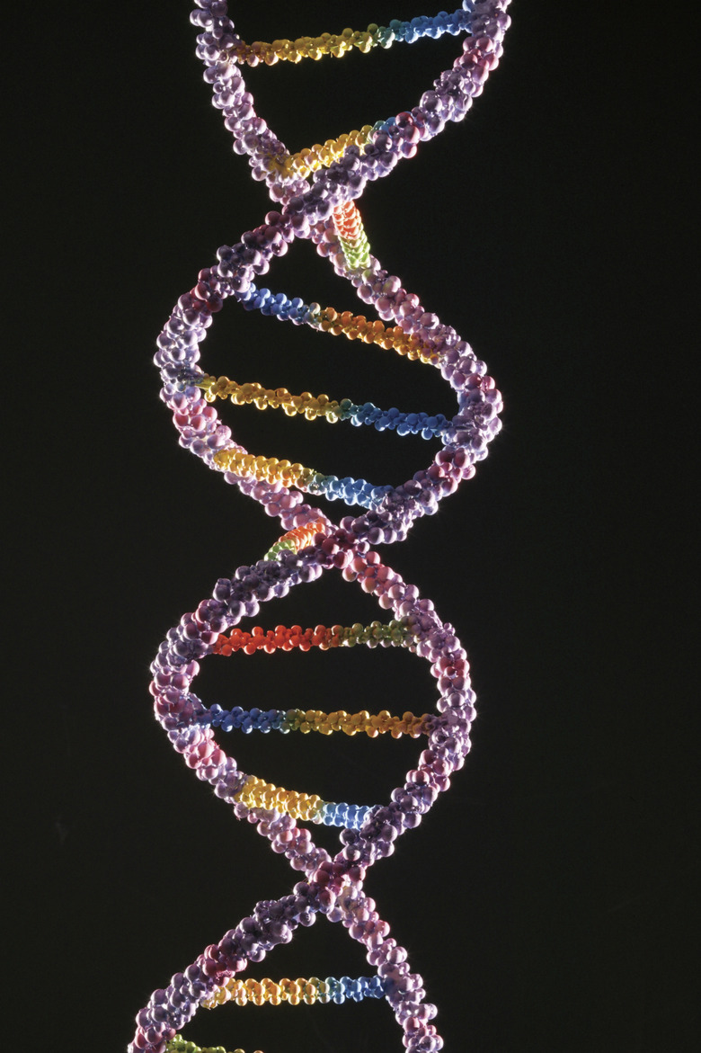
Design Is Seen In Creation
Earth
The Human Body
DNA
I Am Convinced

Slide 6
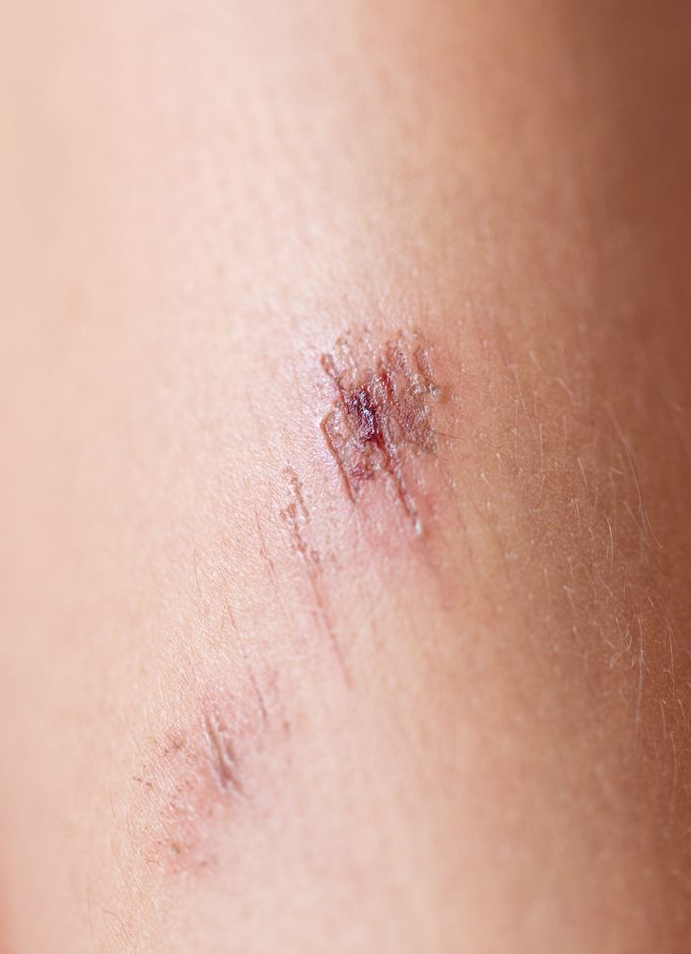
Design Is Seen In Creation
Earth
The Human Body
DNA
Regeneration
“I will give thanks to You, for I am fearfully and wonderfully made”
Psalm 139:14
I Am Convinced

Slide 7
Design Is Seen In Creation
Earth
The Human Body
DNA
Regeneration
Abundance Of Life
“O Lord, how many are Your works! In wisdom You have made them all; The earth is full of Your possessions. There is the sea, great and broad, in which are swarms without number, animals both small and great.” Psalm 145:24-25
I Am Convinced

Slide 8
Design Is Seen In Creation
Earth
The Human Body
DNA
Regeneration
Abundance Of Life
The Ecosystem
“For He draws up the drops of water, They distill rain from the mist, Which the clouds pour down, Thy drip upon man abundantly”
Job 36:37-38
I Am Convinced

Slide 9
Design Is Seen In Creation
Earth
The Human Body
DNA
Regeneration
Abundance Of Life
The Ecosystem
“All the rivers flow into the sea, Yet the sea is not full. To the place where the rivers flow, There they flow again”
Ecclesiastes 1:7
I Am Convinced

Slide 10
Design Is Seen In Creation
Earth
The Human Body
DNA
Regeneration
Abundance Of Life
The Ecosystem
“For since the creation of the world His invisible attributes, His eternal power and divine nature, have been clearly seen, being understood through what has been made”
Romans 1:20
I Am Convinced

Slide 11
Design Is Seen In Creation
Earth
The Human Body
DNA
Regeneration
Abundance Of Life
The Ecosystem
“You are worthy, our Lord and God, to receive glory and honor and power, for You created all things, and by Your will they were created and have their being”
Revelation 4:11
I Am Convinced

Slide 12
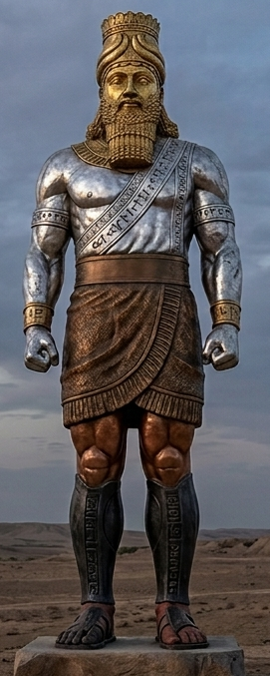
Fulfilled Prophecy
Babylon
Daniel 2
“This was your dream and the visions in your mind while on your bed”
Daniel 2:28
Persians
Greeks
Romans
I Am Convinced
Church

Slide 13
Fulfilled Prophecy
Babylon
Daniel 2
“Surely your God is a God of gods and a Lord of kings and a revealer of mysteries, since you have been able to reveal this mystery”
Daniel 2:47
Persians
Greeks
Romans
I Am Convinced
Church

Slide 14
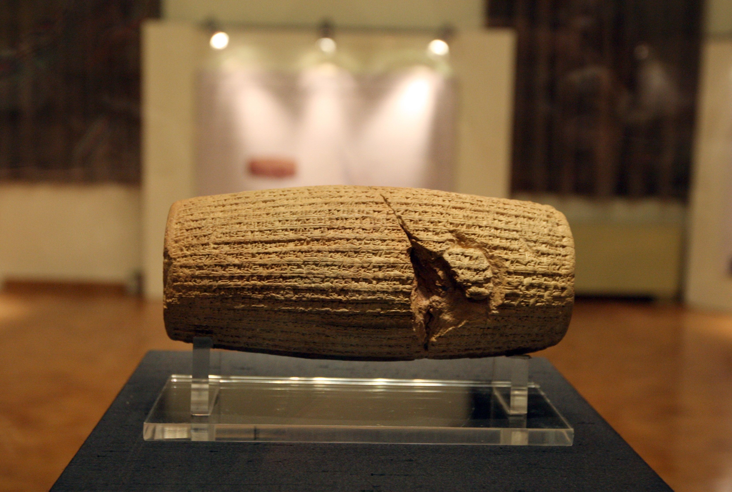
Fulfilled Prophecy
Daniel 2
King Cyrus
Isaiah
44:28
45:1-4
45:13
Ezra
1:2-3
I Am Convinced

Slide 15
Discoveries Validate Scripture
The Hittite Empire
For the Lord had made the army of the Arameans to hear the sound of chariots and the sound of horses, even the sound of a great army, so that they said to one another, ‘behold, the king of Israel has hired against us the kings of the Hittites and the kings of the Egyptians, to come upon us.” 2 Kings 7:6
I Am Convinced

Slide 16
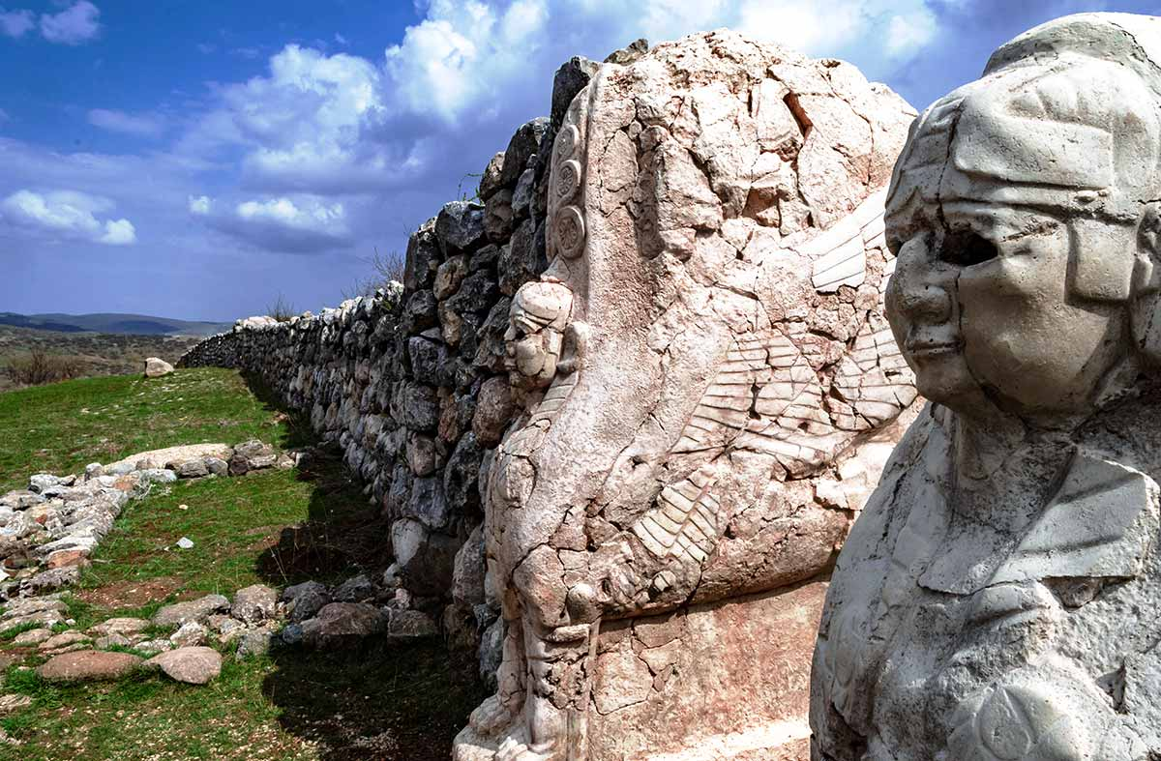
Discoveries Validate Scripture
The Hittite Empire
Hattusa – capital of the Hittites
I Am Convinced

Slide 17
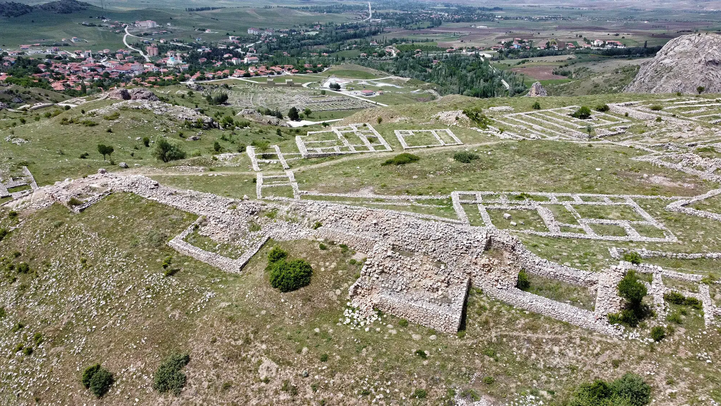
Discoveries Validate Scripture
The Hittite Empire
Hattusa – capital of the Hittites
I Am Convinced

Slide 18
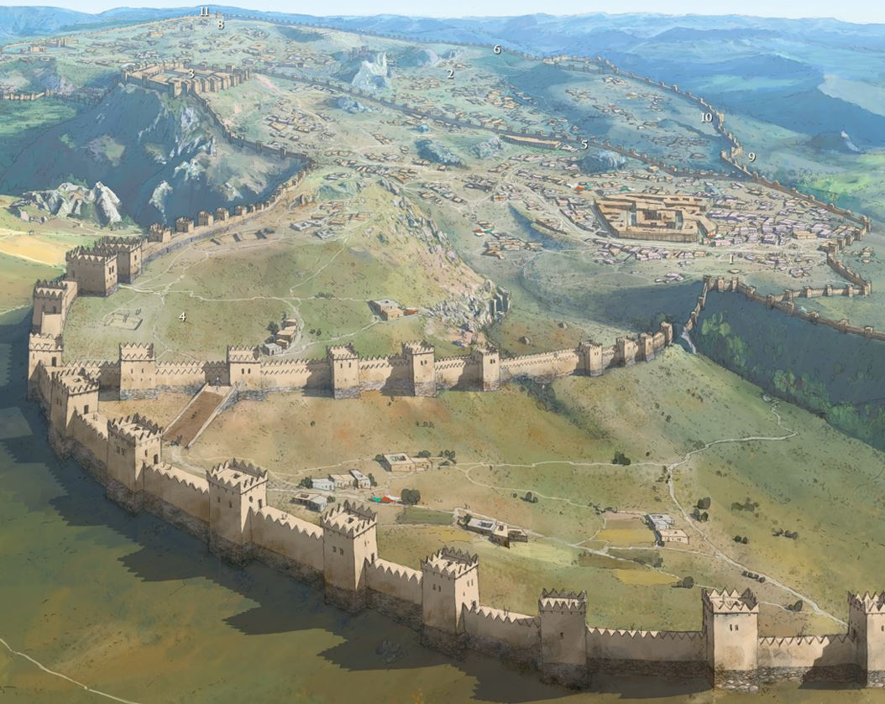
Discoveries Validate Scripture
The Hittite Empire
Hattusa – capital of the Hittites
I Am Convinced

Slide 19
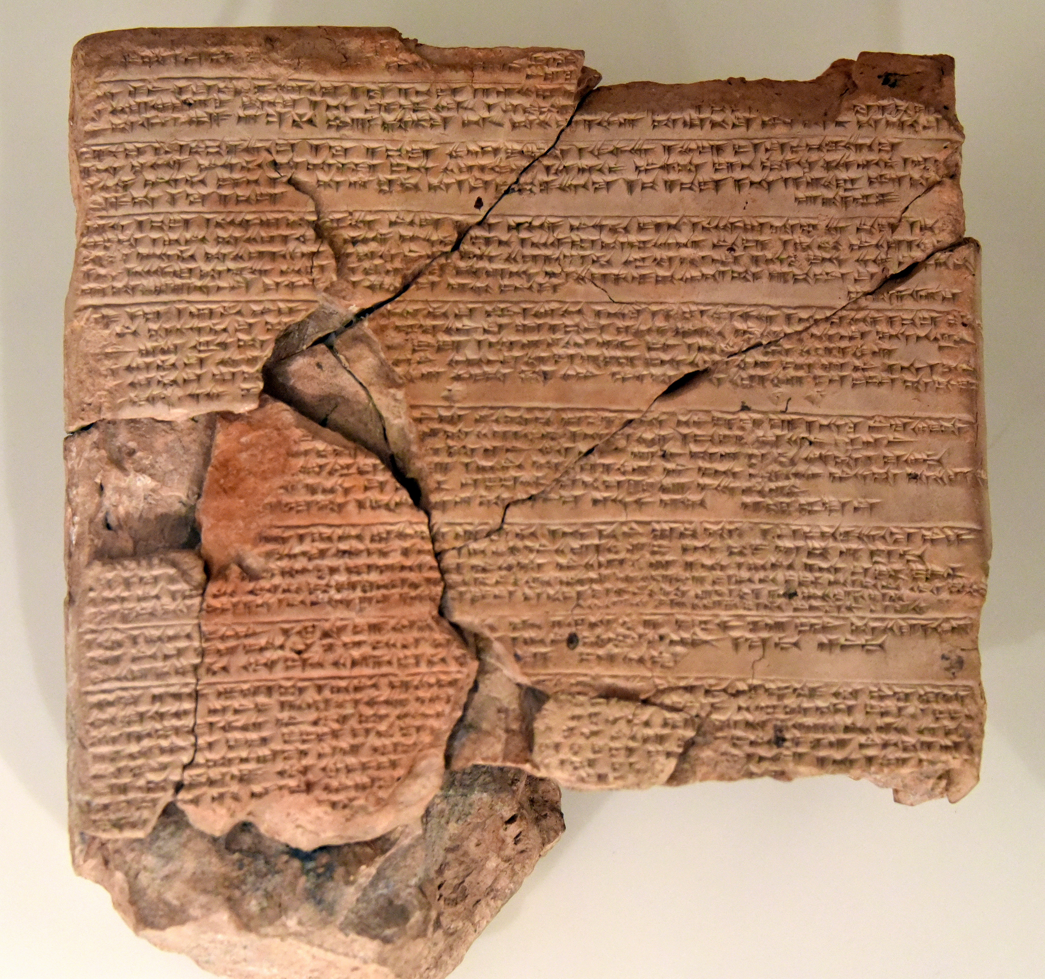
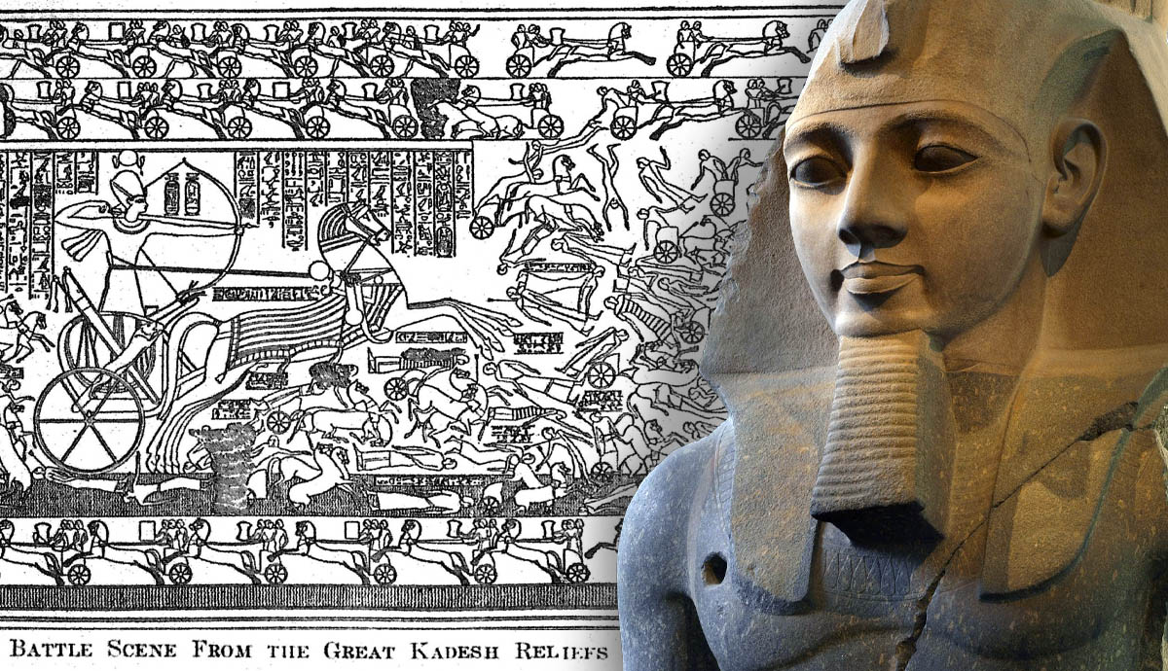
Discoveries Validate Scripture
The Hittite Empire
Hattusa – capital of the Hittites
Hittite
Egyptian
I Am Convinced

Slide 20
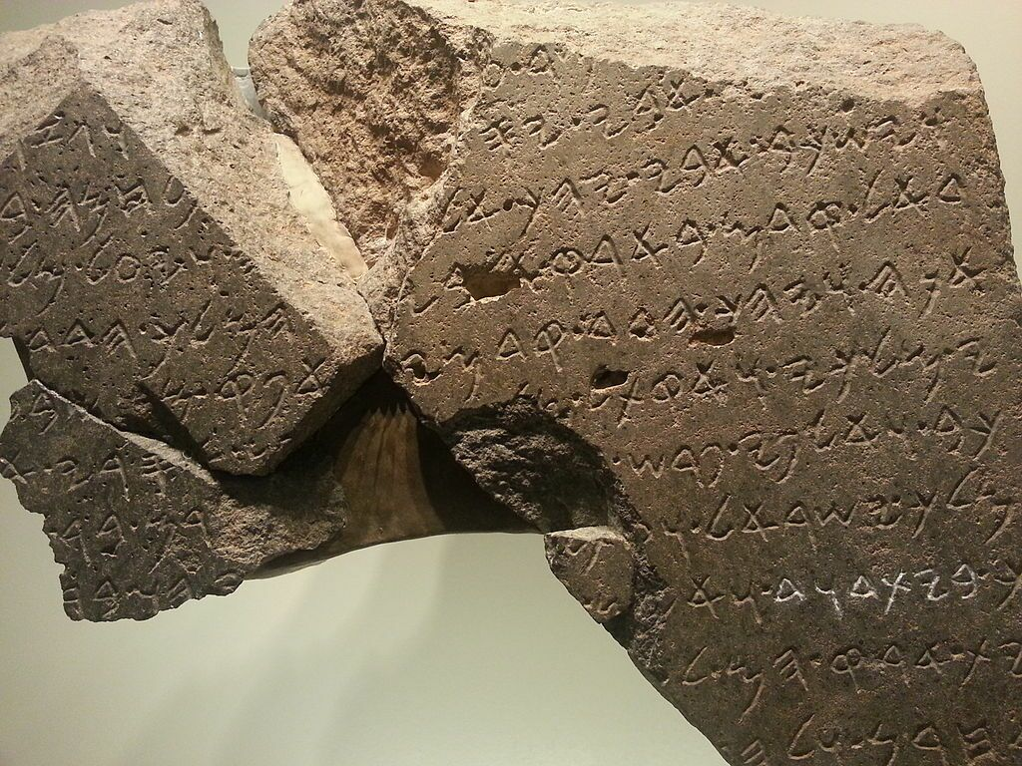
Discoveries Validate Scripture
The Hittite Empire
David’s Rule
Tel Dan Steele
House of David
I Am Convinced

Slide 21
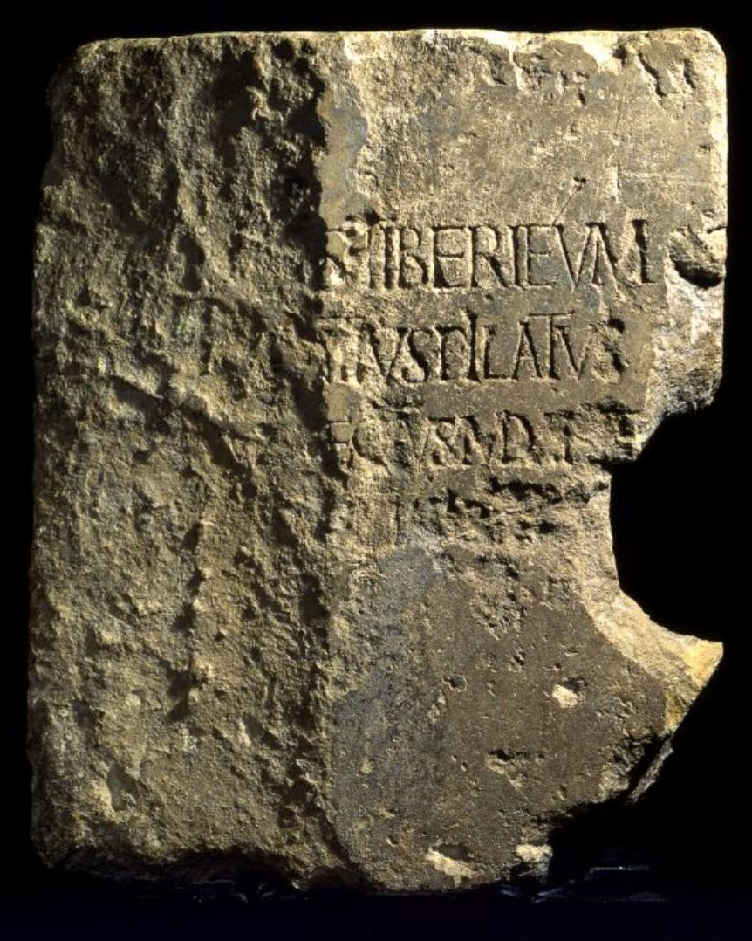
Discoveries Validate Scripture
The Hittite Empire
David’s Rule
Pontius Pilate
Governor of Judea who sentenced Jesus
I Am Convinced

Slide 22
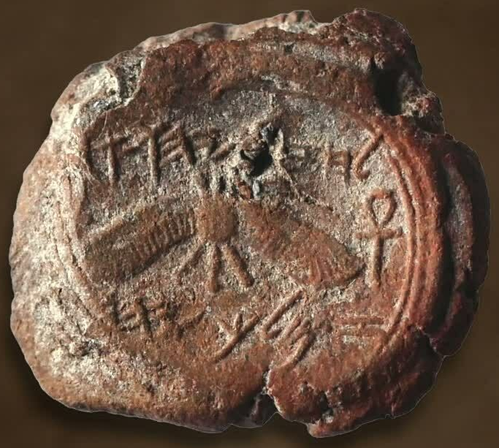
Discoveries Validate Scripture
The Hittite Empire
David’s Rule
Pontius Pilate
King Hezekiah
I Am Convinced

Slide 23
Discoveries Validate Scripture
The Hittite Empire
David’s Rule
Pontius Pilate
King Hezekiah
The Way Of The Sea
“In the past He humbled the land of Zebulun and the land 0f Naphtali, but in the future He will honor Galilee of the Gentiles, by the way of the sea, along the Jordan.” Isaiah 9:1
I Am Convinced

Slide 24
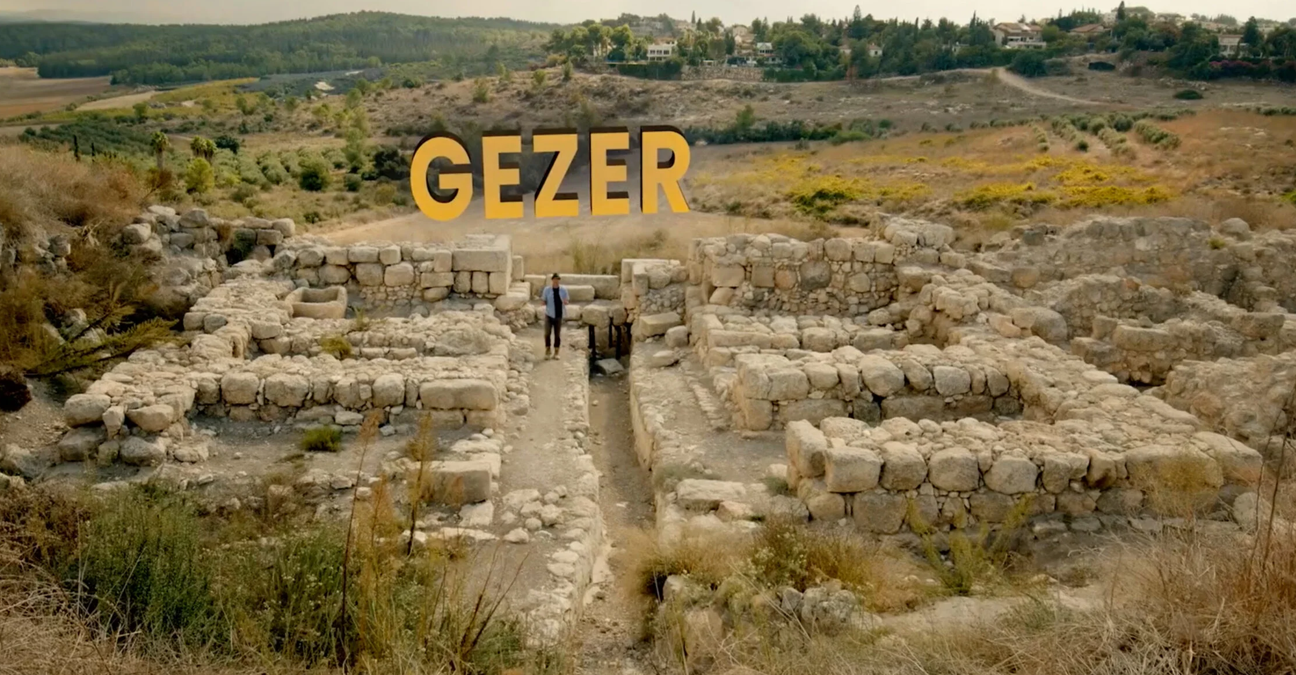
Discoveries Validate Scripture
The Hittite Empire
David’s Rule
Pontius Pilate
King Hezekiah
The Way Of The Sea
I Am Convinced

Slide 25
Discoveries Validate Scripture
The Hittite Empire
David’s Rule
Pontius Pilate
King Hezekiah
The Way Of The Sea
The Appian Way
“And so we came to Rome. And the brethren, when they heard about us, came from there as far as the Market of Appius and Three Inns to meet us; and when Paul saw them, he thanked God and took courage.”
Acts 28:14-15
I Am Convinced

Slide 26
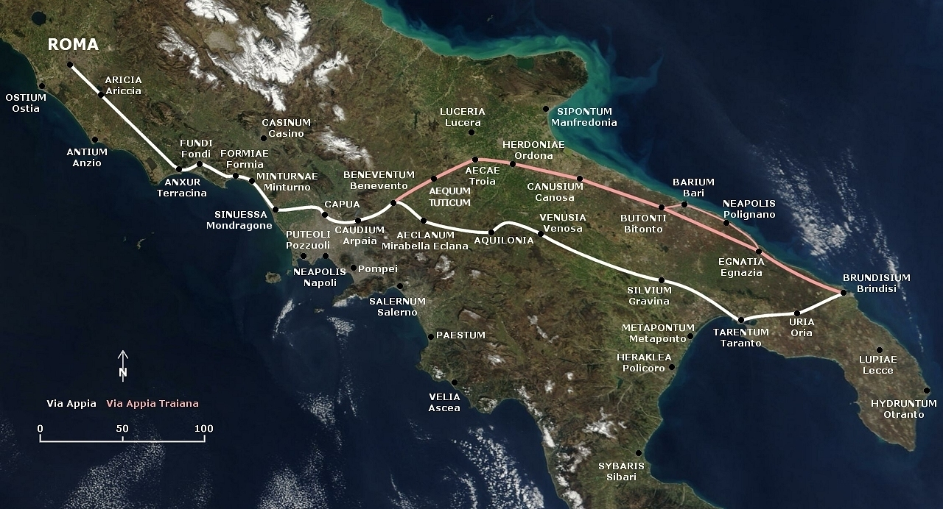
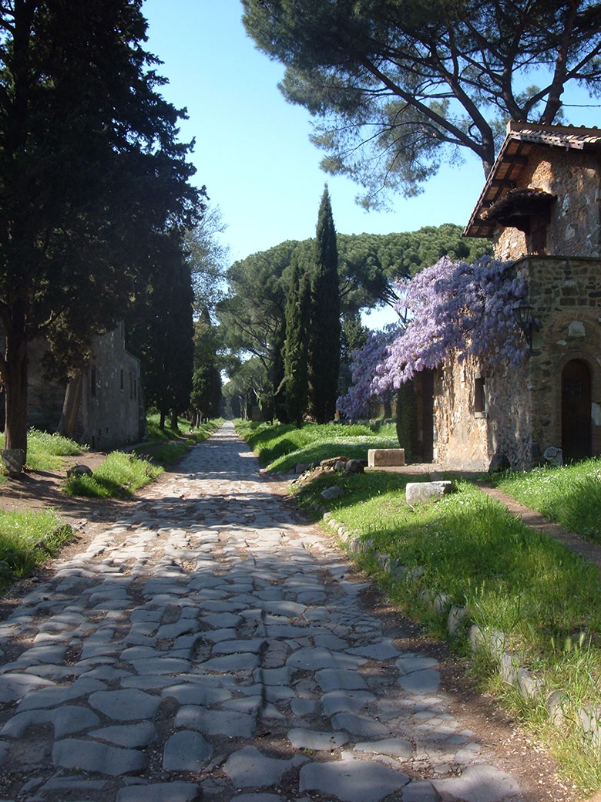
Discoveries Validate Scripture
The Hittite Empire
David’s Rule
Pontius Pilate
King Hezekiah
The Way Of The Sea
The Appian Way
I Am Convinced

Slide 27
Discoveries Validate Scripture
The Hittite Empire
David’s Rule
Pontius Pilate
King Hezekiah
The Way Of The Sea
The Appian Way
The King’s Highway
“Please let us pass through your land. We will not pass through field or vineyard; we will not drink water from a well. We will go along the king’s highway, until we pass through your territory.”
Numbers 20:17
I Am Convinced

Slide 28
Discoveries Validate Scripture
The Hittite Empire
David’s Rule
Pontius Pilate
King Hezekiah
The Way Of The Sea
The Appian Way
The King’s Highway
“The Israelites sent messengers to Sihon, king of the Amorites, saying, “Let me pass through your land. We will not turn off into field or vineyard; we will not drink water from wells. We will go by the king’s highway until we have passed through your border”
Numbers 21:22-23
I Am Convinced

Slide 29
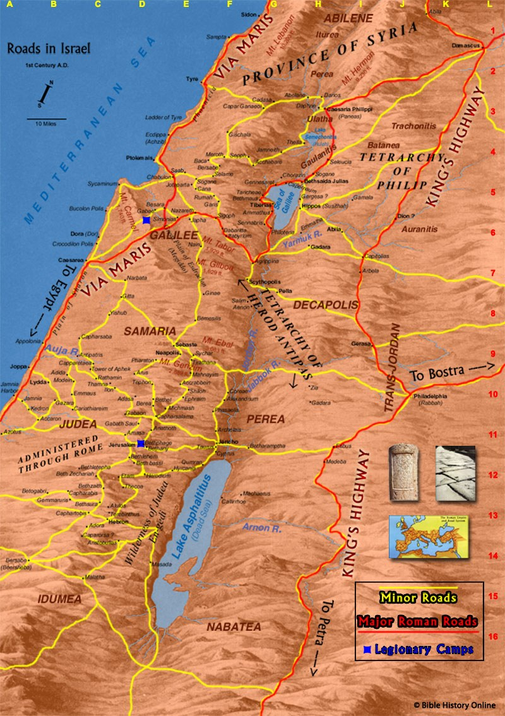
Discoveries Validate Scripture
The Hittite Empire
David’s Rule
Pontius Pilate
King Hezekiah
The Way Of The Sea
The Appian Way
The King’s Highway
Numbers 20:17 21:22-23
I Am Convinced

Slide 30
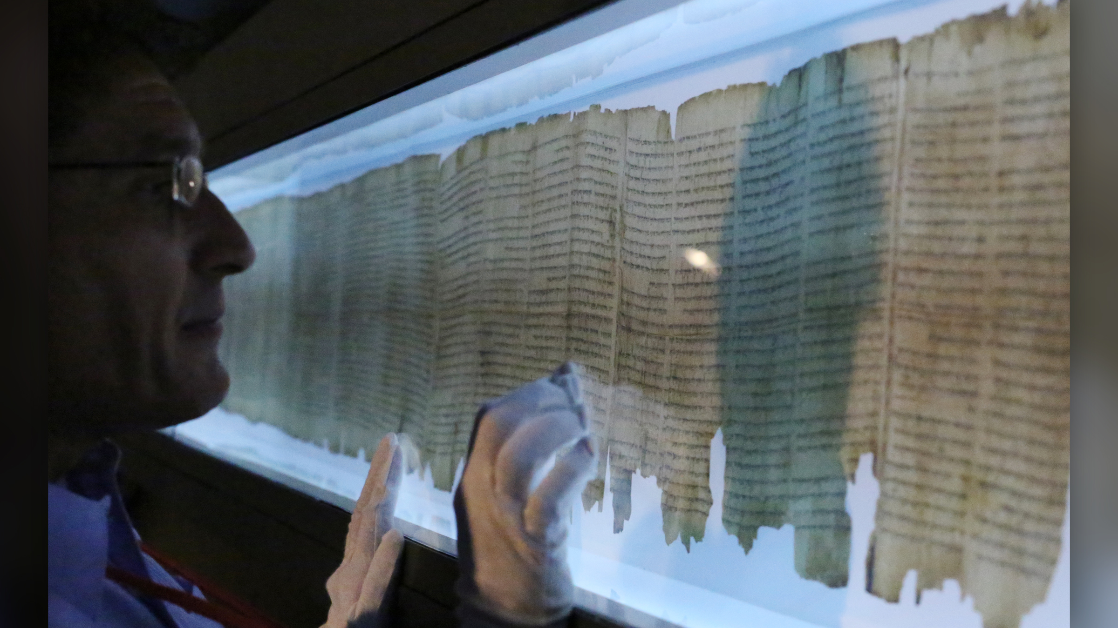
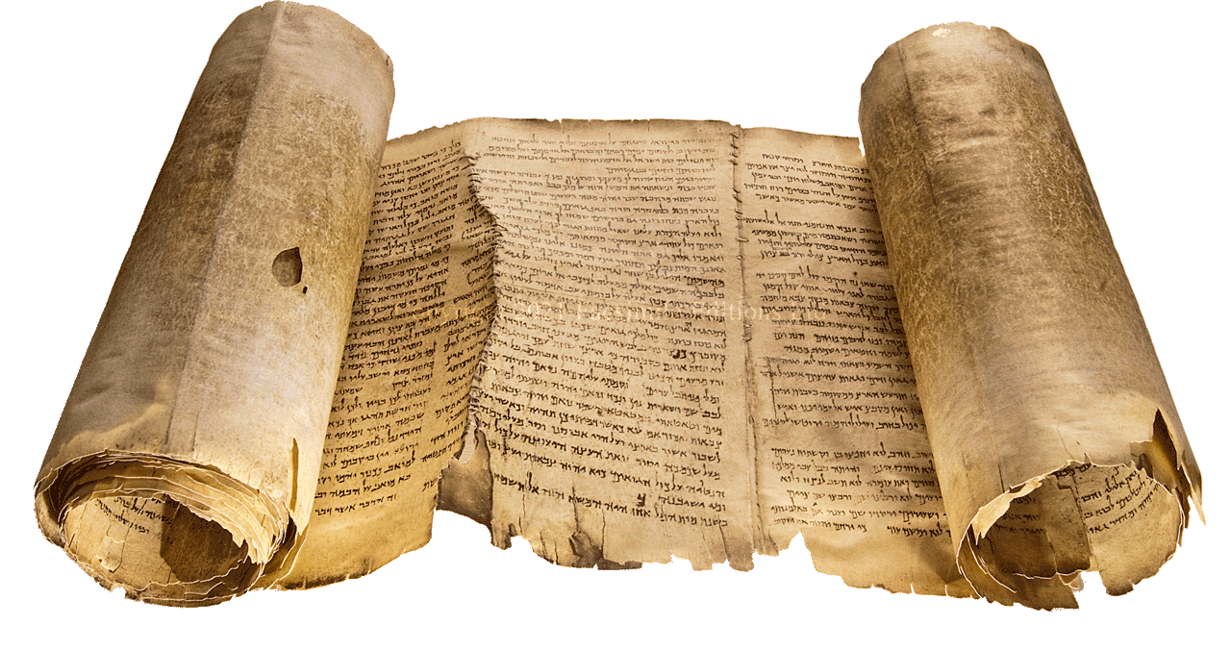
Discoveries Validate Scripture
The Hittite Empire
David’s Rule
Pontius Pilate
King Hezekiah
The Way Of The Sea
The Appian Way
The King’s Highway
Dead Sea Scrolls
I Am Convinced

Slide 31
Are You Convinced?
We Must Listen To God
1 John 8:24
“unless you believe that I am He, you will die in your sins”

Slide 32
Are You Convinced?
We Must Listen To God
1 John 8:24
Luke 13:3
“unless you repent, you will all likewise perish”

Slide 33
Are You Convinced?
We Must Listen To God
1 John 8:24
Luke 13:3
Romans 10:19
“if you confess with your mouth Jesus as Lord, and believe in your heart that God raised Him from the dead, you will be saved.”

Slide 34
Are You Convinced?
We Must Listen To God
1 John 8:24
Luke 13:3
Romans 10:19
1 Peter 3:21
“baptism now saves you”

Slide 35
Are You Convinced?
We Must Listen To God
1 John 8:24
Luke 13:3
Romans 10:19
1 Peter 3:21
Acts 2:38
“for the forgiveness of sin”

Slide 36
Are You Convinced?
We Must Listen To God
1 John 8:24
Luke 13:3
Romans 10:19
1 Peter 3:21
Acts 2:38
2 Timothy 2:12
“I know whom I have believed and I am convinced that He is able to guard what I have entrusted to Him until that day”

