Slide 2

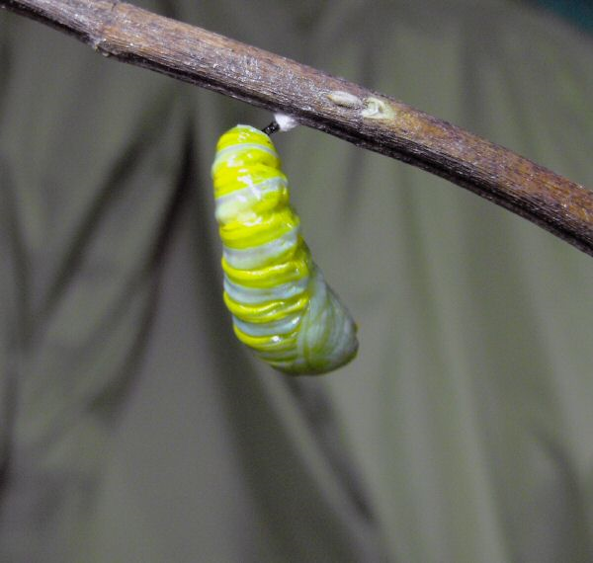
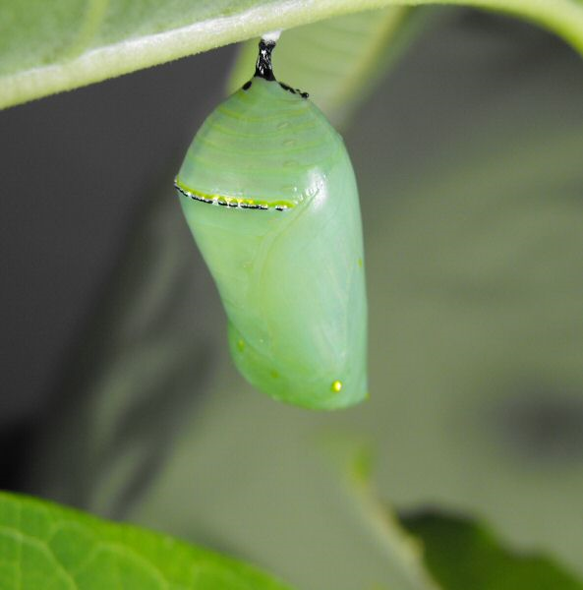
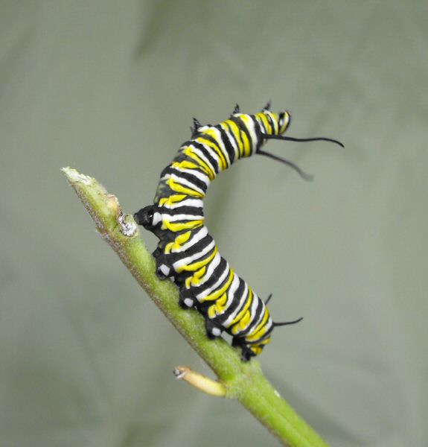
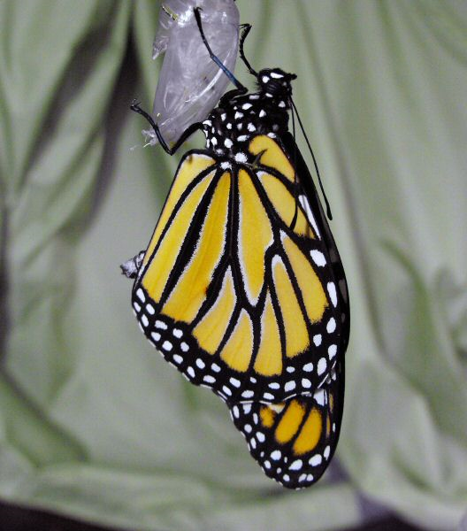
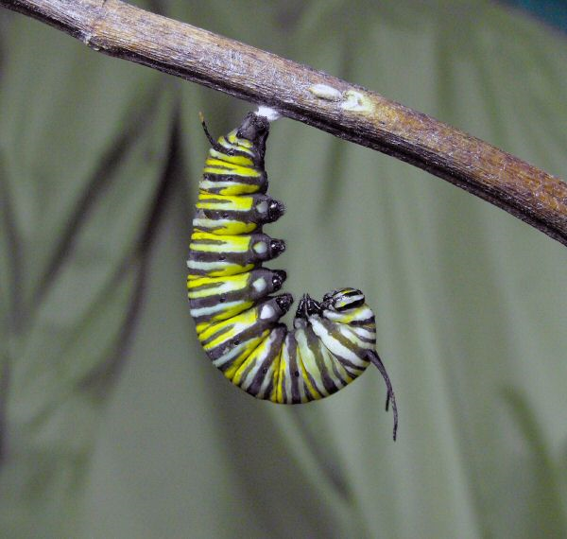
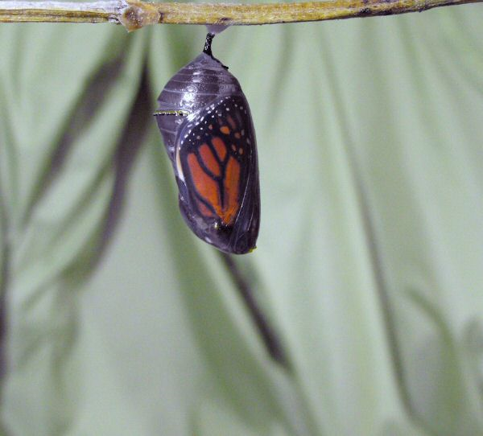
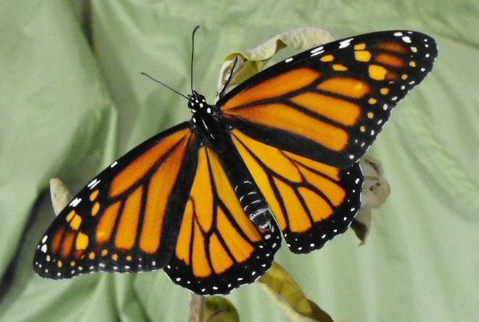
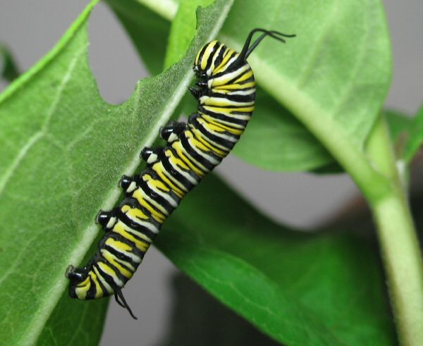
Transformation
Romans 12:1-2
Greek =
Metamorphoo
Change into another form

Slide 3
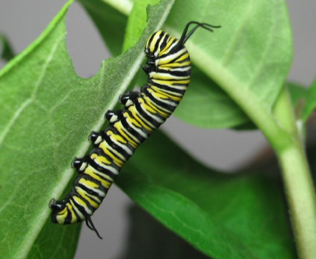
Transformation
-A Decision-
“the renewing of your mind”
Only possible through “renewal”.
The renewal (renovation) of our “mind”.
Change your mind about spiritual matters.
Ezekiel 18:31; Ephesians 4:22-24

Slide 4
Renewal Causes Us To Prove God’s Will
“Prove” = test, examine, scrutinize
“Good” – useful; happy/agreeable; excellent
“Acceptable” – well pleasing
“Perfect” – complete; mature; finished
2 Corinthians 5:17
Colossians 3:10
Ephesians 5:17

Slide 5
Ephesians 4:21-32
Renewed (v.23)
Speak truth (v.25)
Be angry, yet do not sin (v.26)
Don’t steal, work (v.28)
No unwholesome words, but words that edify (v.29)
No bitterness or wrath… (v.31-32)
Holy & Acceptable
Spiritual service of worship
“Presenting” = to place beside or near…present for another to see
Romans 13:14
Renewal Creates Desire To Present Body As A Living Sacrifice

Slide 6
2 Corinthians 3:18 “changed”
1 Corinthians 6:9-11
We need to be changed!

