Slide 2
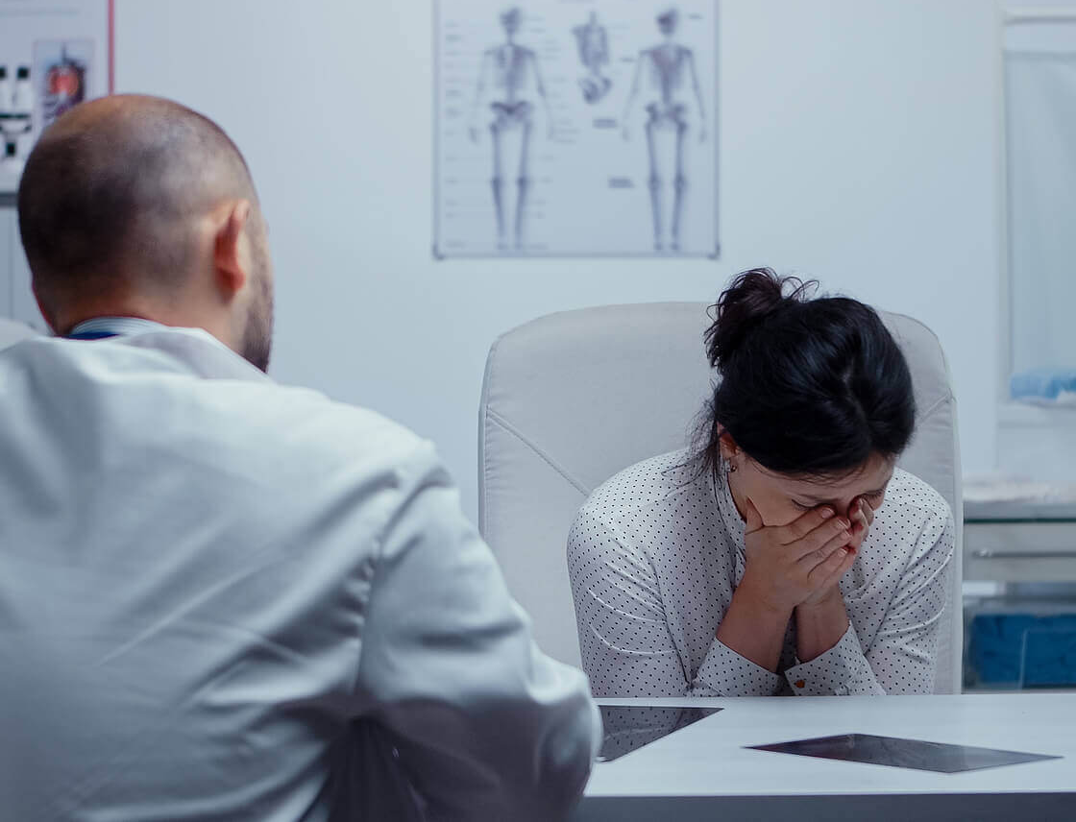
Human Suffering
Job 7:17-21

Slide 3
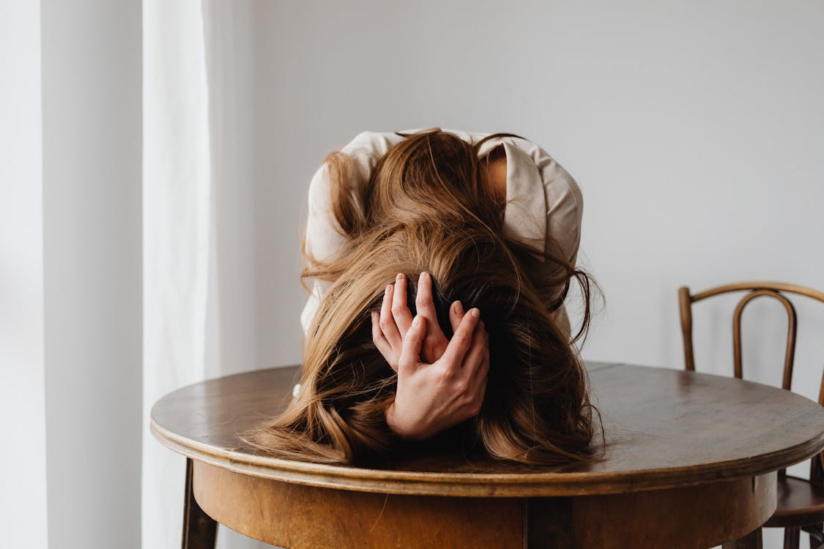
Suffering brings up questions of blame
If I’m not bad enough to deserve this, does that mean God is unfair? (Job 7:17-21)
Bible blames humans for suffering (Genesis 3:15-19; Hosea 8:1-7; Job 22:23; Gal. 6:8)
Why Me?
Not all suffering is a result of sin
(Rom. 5:3; James 1:3)
Jesus Brings Comfort! (John 9:1-7)

Slide 4
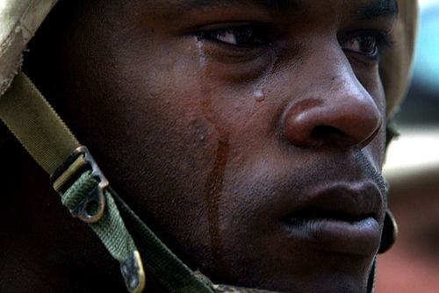
What Possible Good Can Come From This?
We become better people because of suffering (Job 5:17; Romans 5:3-4)
Sometimes our suffering benefits someone else (Is. 53; Gen.50:15-21)
Finding Meaning Helps

Slide 5


Why Doesn’t God Do Something?
We understand God is in charge
We want God to be all-powerful and merciful
Our experiences leave us baffled
Job 6:8-13
2 Corinthians 12:7-10
Matthew 26:39

Slide 6
Why me?
Can any good come from this?
Why doesn’t God do something?
Are you suffering in sin?
Human Suffering

