Slide 2
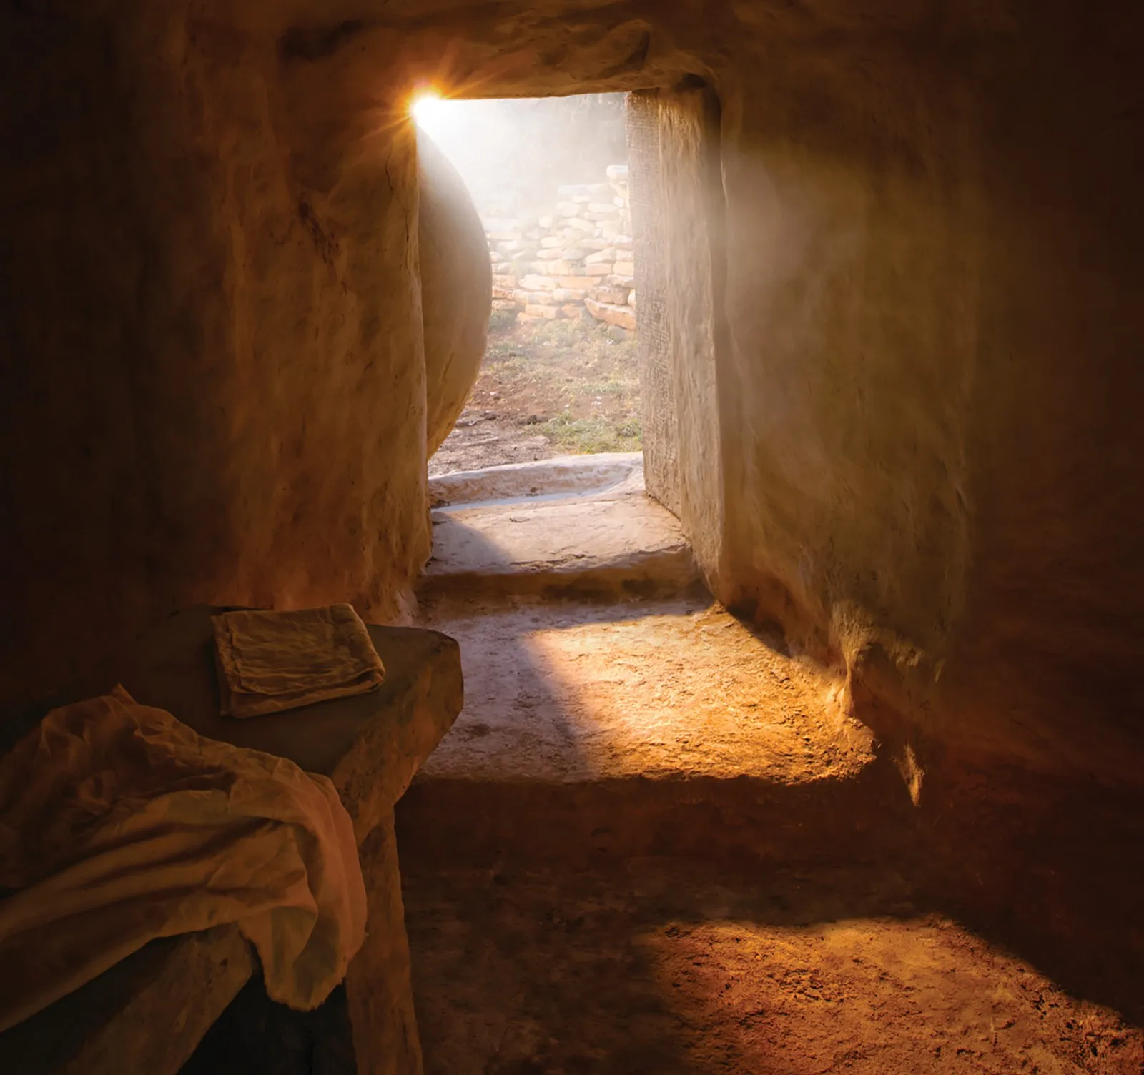
The Resurrection Of Christ
1 Corinthians 15

Slide 3
1 Corinthians 15:1-4
“Now I make known to you, brethren, the gospel which I preached to you, which also you received, in which also you stand, by which also you are saved, if you hold fast the word which I preached to you, unless you believed in vain. For I delivered to you as of first importance what I also received, that Christ died for our sins according to the Scriptures, and the He was buried, and that He was raised on the third day according to the Scriptures.”
The Resurrection Of Christ

Slide 4
1 Corinthians 15:1-2
“Now I make known to you, brethren, the gospel which I preached to you, which also you received, in which also you stand, by which also you are saved, if you hold fast the word which I preached to you, unless you believed in vain.”
Romans 1:16 “For I am not ashamed of the gospel, for it is the power of God for salvation to everyone who believes, to the Jew first and also to the Greek.”
The Resurrection Of Christ

Slide 5
Romans 16:15-16 “Now to Him who is able to establish you according to my gospel and the preaching of Jesus Christ, according to the revelation of the mystery which has been kept secret for long ages past, but now is manifested, and by the Scriptures of the prophets, according to the commandment of the eternal God, has been made known to all the nations, leading to obedience of faith”
The Resurrection Of Christ

Slide 6
1 Corinthians 15:3
“For I delivered to you as of first importance what I also received”
“Christ died for our sins according to the Scriptures”
Isaiah 53:5 “He was pierced through for our transgressions, He was crushed for our iniquities”
Isaiah 53:12 “He Himself bore the sin of many”
The Resurrection Of Christ

Slide 7
1 Corinthians 15:3
“For I delivered to you as of first importance what I also received”
“Christ died for our sins according to the Scriptures”
John 10:15 “I lay down My life for the sheep”
1 Peter 3:18 “For Christ also died for sin once for all, the just for the unjust, so that He might bring us to God”
The Resurrection Of Christ

Slide 8
1 Corinthians 15:3
“For I delivered to you as of first importance what I also received”
1 Corinthians 15:4 “was buried”
Isaiah 53:9 “His grave was assigned with wicked men, Yet He was with a rich man in His death”
The Resurrection Of Christ

Slide 9
Matthew 27:57-60 “When it was evening, there came a rich man from Arimathea, named Joseph, who himself had also become a disciple of Jesus. This man went to Pilate and asked for the body of Jesus. Then Pilate ordered it to be given to him. And Joseph took the body and wrapped it in a clean linen cloth, and laid it in his own new tomb, which he had hewn out in the rock; and he rolled a large stone against the entrance of the tomb and went away”
The Resurrection Of Christ

Slide 10
1 Corinthians 15:4
“For I delivered to you as of first importance what I also received”
“raised the third day according to the Scriptures”
Acts 2:24 “God raised Him up again”
Acts 13:29 “When they had carried out all that was written concerning Him, they took Him down from the cross and laid Him in a tomb. But god raised Him from the dead.”
The Resurrection Of Christ

Slide 11
1 Corinthians 15:4
“For I delivered to you as of first importance what I also received”
“raised the third day according to the Scriptures”
Acts 13:34 “As for the fact that He raised Him up from the dead, no longer to return to decay, He has spoken in this way: ‘I will give you the holy and sure blessing of David’” (Isaiah 55:3)
The Resurrection Of Christ

Slide 12
1 Corinthians 15:4
“For I delivered to you as of first importance what I also received”
“raised the third day according to the Scriptures”
Acts 13:35 “Therefore He also says in another Psalm, You will not allow Your Holy One to undergo decay” (Psalm 16:10)
The Resurrection Of Christ

Slide 13
1 Corinthians 15:5-8
“and that He appeared to Cephas, then to the twelve. After that He appeared to more than five hundred brethren at one time, most of whom remain until not, but some have fallen asleep; then He appeared to James, then to all the apostles; and last of all, as to one untimely born, He appeared to me also.”
Cephas/Peter
Luke 24:34 “The Lord has really risen and has appeared to Simon”
The Resurrection Of Christ

Slide 14
1 Corinthians 15:5-8
“and that He appeared to Cephas, then to the twelve. After that He appeared to more than five hundred brethren at one time, most of whom remain until not, but some have fallen asleep; then He appeared to James, then to all the apostles; and last of all, as to one untimely born, He appeared to me also.”
The Twelve
Luke 24:36 “While they were telling these things, He Himself stood in their midst and said to them, ‘Peace be to you.’”
The Resurrection Of Christ

Slide 15
1 Corinthians 15:5-8
“and that He appeared to Cephas, then to the twelve. After that He appeared to more than five hundred brethren at one time, most of whom remain until not, but some have fallen asleep; then He appeared to James, then to all the apostles; and last of all, as to one untimely born, He appeared to me also.”
The 500
The Resurrection Of Christ

Slide 16
1 Corinthians 15:5-8
“and that He appeared to Cephas, then to the twelve. After that He appeared to more than five hundred brethren at one time, most of whom remain until not, but some have fallen asleep; then He appeared to James, then to all the apostles; and last of all, as to one untimely born, He appeared to me also.”
James, then all the Apostles
Acts 1:8 “you will receive power when the Holy Spirit has come upon you; and you shall be My witnesses in both Jerusalem, and in all Judea and Samaria, and even to the remotest part of the earth”
The Resurrection Of Christ

Slide 17
1 Corinthians 15:5-8
“and that He appeared to Cephas, then to the twelve. After that He appeared to more than five hundred brethren at one time, most of whom remain until not, but some have fallen asleep; then He appeared to James, then to all the apostles; and last of all, as to one untimely born, He appeared to me also.”
He appeared to me also
Acts 9:5 “I am Jesus whom you are persecuting…”
The Resurrection Of Christ

Slide 18
A Lie Was Circulated
Matthew 28:11-15
“Now while they were on their way, some of the guard came into the city and reported to the chief priests all that had happened. And when they had assembled with the elders and consulted together, they gave a large sum of money to the soldiers, and said “You are to say, ‘His disciples came by night and stole Him away while we were asleep.’ And if this should come to the governor’s ears, we will win him over and keep you out of trouble.” And they took the money and did as they had been instructed; and this story was widely spreading among the Jews, and is to this day”
The Resurrection Of Christ

Slide 19
1 Corinthians 15:12-15
“Now if Christ is preached, that He has been raised from the dead, how do some among you say that there is no resurrection from the dead? But if there is no resurrection of the dead, not even Christ has been raised; and if Christ has not been raised, then our preaching is vain, your faith also is vain. Moreover we are even found to be false witnesses of God, because we testified against God that He raised Christ, whom He did not raise, if in fact the dead are not raised”
The Resurrection Of Christ

Slide 20
All Will Be Resurrected
John 5:28-29
“an hour is coming, in which all who are in the tombs will hear His voice, and will come forth; those who did the good deeds to a resurrection of life, those who committed the evil deeds to a resurrection of judgment”
The Resurrection Of Christ

Slide 21
All Will Be Resurrected
Acts 24:15
“there shall certainly be a resurrection of both the righteous and the wicked”
The Resurrection Of Christ

Slide 22
All Will Be Resurrected
Romans 2:5-11
“But because of your stubbornness and unrepentant heart you are storing up wrath for yourself in the day of wrath and revelation of the righteous judgment of God, who will render to each person according to his deeds: to those who by perseverance in doing good seek for glory and honor and immortality, eternal life; but to those who are selfishly ambitious and do not obey the truth, but obey unrighteousness, wrath and indignation. There will be tribulation and distress for every soul of man who does evil, of the Jew first and also of the Greek, but glory and honor and peace to everyone who does good, to the Jew first and also to the Greek. For there is no partiality with God.”
The Resurrection Of Christ

Slide 23
All Will Be Resurrected
2 Corinthians 5:10
“we must all appear before the judgment seat of Christ, so that each one may be recompensed for his deeds in the body, according to what he has done, whether good or bad.”
The Resurrection Of Christ

Slide 24
1 Corinthians 15:14 If Christ has NOT been raised…
“Our preaching is vain”
“Your faith is vain”
“We are even found to be false witnesses, because we testified against God that He raised Christ”
Acts 2:32 “This Jesus God raised up again”
Acts 4:33 “the apostles were giving testimony to the resurrection of the Lord Jesus”
Acts 13:30 “God raised Him from the dead”
Acts 5:30 “The God of our fathers raised up Jesus”
The Resurrection Of Christ

Slide 25
1 Corinthians 15:14 If Christ has NOT been raised…
“Our preaching is vain”
“Your faith is vain”
“We are even found to be false witnesses, because we testified against God that He raised Christ”
Acts 13:33 “He raised up Jesus”
Galatians 1:1 “who raised Him from the dead”
Acts 17:31 “by raising Him from the dead”
Romans 6:9-10 “having been raised from the dead”
The Resurrection Of Christ

Slide 26
1 Corinthians 15:16-19
“For if the dead are not raised, not even Christ has been raised; and if Christ has not been raised, your faith is worthless; you are still in your sins. Then those also who have fallen asleep in Christ have perished. If we have oped in Christ in this life only, we are of all men most to be pitied.”
The Resurrection Of Christ

Slide 27
1 Corinthians 15:14 If Christ has NOT been raised…
“Our preaching is vain”
“Your faith is vain”
“We are even found to be false witnesses, because we testified against God that He raised Christ”
“Your faith is worthless; you are still in your sins”
Romans 4:25 “He who was delivered over because of our transgressions, and was raised because of our justification”
The Resurrection Of Christ

Slide 28
1 Corinthians 15:14 If Christ has NOT been raised…
“Our preaching is vain”
“Your faith is vain”
“We are even found to be false witnesses, because we testified against God that He raised Christ”
“Your faith is worthless; you are still in your sins”
Romans 5:10 “For if while we were enemies we were reconciled to God through the death of His Son, much more, having been reconciled, we shall be saved by His life”
The Resurrection Of Christ

Slide 29
1 Corinthians 15:14 If Christ has NOT been raised…
“Our preaching is vain”
“Your faith is vain”
“We are even found to be false witnesses, because we testified against God that He raised Christ”
“Your faith is worthless; you are still in your sins”
1 Peter 1:3 “Blessed be the God and Father of our Lord Jesus Christ, who according to His great mercy has caused us to be born again to a living hope through the resurrection of Jesus Christ from the dead”
The Resurrection Of Christ

Slide 30
1 Corinthians 15:14 If Christ has NOT been raised…
“Our preaching is vain”
“Your faith is vain”
“We are even found to be false witnesses, because we testified against God that He raised Christ”
“Your faith is worthless; you are still in your sins”
1 Thessalonians 4:14 “if we believe that Jesus rose again, even so God will bring with Him those who have fallen asleep in Jesus”
The Resurrection Of Christ

Slide 31
1 Corinthians 15:14 If Christ has NOT been raised…
“Our preaching is vain”
“Your faith is vain”
“We are even found to be false witnesses, because we testified against God that He raised Christ”
“Your faith is worthless; you are still in your sins”
Romans 8:11 “Bit if the Spirit of Him who raised Jesus from the dead dwells in you, He who raised Christ Jesus from the dead will also give life to your mortal bodies through His Spirit who dwells in you.”
The Resurrection Of Christ

Slide 32
1 Corinthians 15:14 If Christ has NOT been raised…
“Our preaching is vain”
“Your faith is vain”
“We are even found to be false witnesses, because we testified against God that He raised Christ”
“Your faith is worthless; you are still in your sins”
Romans 8:34 “Christ Jesus is He who died, yes, rather who was raised, who is at the right hand of God, who also intercedes for us”
The Resurrection Of Christ

Slide 33
1 Corinthians 15:14 If Christ has NOT been raised…
“Our preaching is vain”
“Your faith is vain”
“We are even found to be false witnesses, because we testified against God that He raised Christ”
“Your faith is worthless; you are still in your sins”
Hebrews 7:25 “He is able to save forever those who draw near to God through Him, since He always lives to make intercession for them.”
The Resurrection Of Christ

Slide 34
1 Corinthians 15:20
“But now Christ has been raised from the dead, the first fruits of those who are asleep”
Do you have the hope of eternal life?
Are you “holding fast the word” (1 Corinthians 15:2)?
The Resurrection Of Christ

