Slide 2
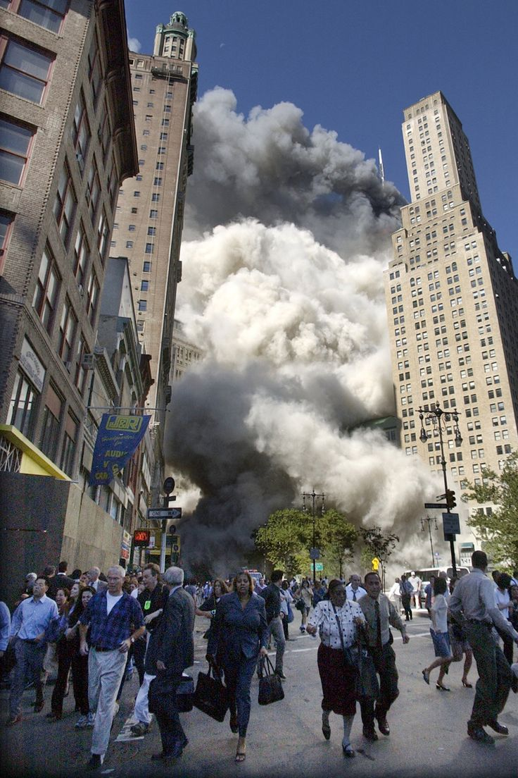
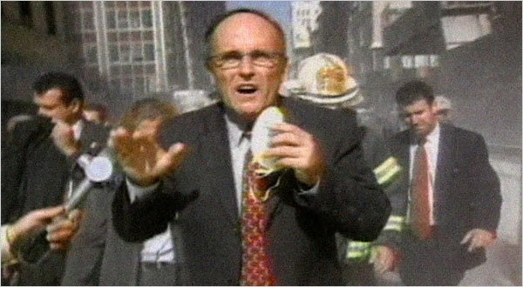
Righteous
In The Midst Of
Unrighteousness
Quality Stands Out When Surrounded By Junk
The Christian Is To Stand Out From The World

Slide 3
Righteousness Is NOT
Dependent On What Men Teach
Elijah and Prophets of Baal (1 Kings 16:29-33; 18:20-24; 39-40)
We must depend on God’s word, not false teaching (Matt. 5:19; Eph. 4:14; 1 Tim. 1:3)
We must follow the doctrine of Christ (Titus 1:9; 2 John 9; Gal. 1:8-9)

Slide 4
Righteousness Does NOT
Follow The Example Of Men
Elijah thought he was only one left (1 Kings 19:14-18)
Some at Mt. Sinai remained faithful (Ex.32:21-28)
Malachi 3:13-18 (those who feared the Lord)
Revelation 3:1-5 (a few in Sardis)
We must follow Jesus (Matt. 16:24; John 10:27; 1 Cor. 11:1; 1 Peter 2:21)

Slide 5
Righteousness Is NOT
Dependent On Others
Noah truly was alone (Gen. 6:5-8; 7:1)
2 Timothy 4:16-18 no one stood with Paul
Salvation is not corporate! (Rom. 14:2; 2 Cor. 5:10; 1 Pet. 4:4-5)

Slide 6
Self-Control Is Difficult When Surrounded By Unrighteousness
1 John 1:9; Romans 6:11-13
Be wary of “sensuality”
(Jude 19; James 3:14-16)
Be wary of materialism
(Luke 18:24-25; 1 Tim. 6:9-11)
Be wary of selfishness
(1 Cor. 13:3; Eph. 4:28; Rom. 12:13;
1 Tim. 6:17-18)

Slide 7
Cannot follow teaching of men,
but abide in doctrine of Christ
Cannot follow example of men,
but follow Christ.
Cannot depend on others but must each
be responsible for our own righteousness.
While in midst of unrighteousness,
we must remain righteous.
ARE WE?

