Slide 2
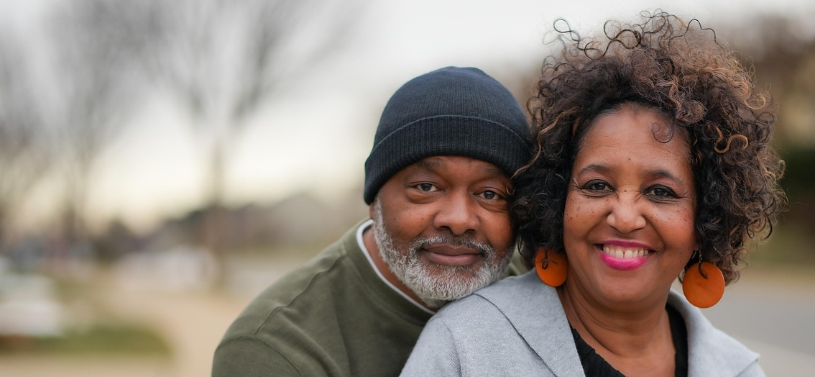
Growing Old
Gracefully

Slide 3
Examples
Genesis 13:8-9
2 Timothy 4:6-8
Peter (1 Pet. 5:1-2; 2 Pet 1:13-15; 3:15)
Growing Old
Gracefully

Slide 4
Principles
Reap What You Sow
Galatians 6:7-8; 5:19-23
Hosea 10:12
Growing Old
Gracefully

Slide 5
Principles
Living By God’s Word
Matthew 4:4 (Deuteronomy 8:3)
Luke 12:15
Ecclesiastes 2:17-23
John 10:10; 14:46
Luke 9:25; 12:15-21
Growing Old
Gracefully

Slide 6
Principles
Finding Wisdom
Knowledge applied (Prov. 3:13-18; Eph. 5:15-16; James 4:14)
Proverbs 2:6; 3:19-20
Learn this early! (Prov. 3:21-26; Ps. 119:97-100; 2 Tim. 3:15)
Growing Old
Gracefully

Slide 7
Practical Steps
Be An Example
1 Timothy 4:12
Proverbs 14:18
Ecclesiastes 10:1
Growing Old
Gracefully

Slide 8
Practical Steps
Commit Yourself To God’s Word
2 Peter 3:17
1 Timothy 4:13
2 Timothy 2:15
Psalm 119:11
Growing Old
Gracefully

Slide 9
Practical Steps
Cultivate Your Talents
1 Timothy 4:14
Growing Old
Gracefully

Slide 10
Practical Steps
Apply Diligence To Your Efforts
1 Timothy 4:15-16
Psalm 1:2-3
1 Peter 4:9-11
Growing Old
Gracefully

Slide 11
Growing Old
Gracefully
“The righteous man will flourish like the palm tree, He will grow like a cedar in Lebanon. Planted in the house of the Lord, They will flourish in the courts of our God. They will still yield fruit in old age; They shall be full of sap and very green, To declare that the Lord is upright; He is my rock, and there is no unrighteousness in him.” (Ps. 92:12-15)

