Slide 2
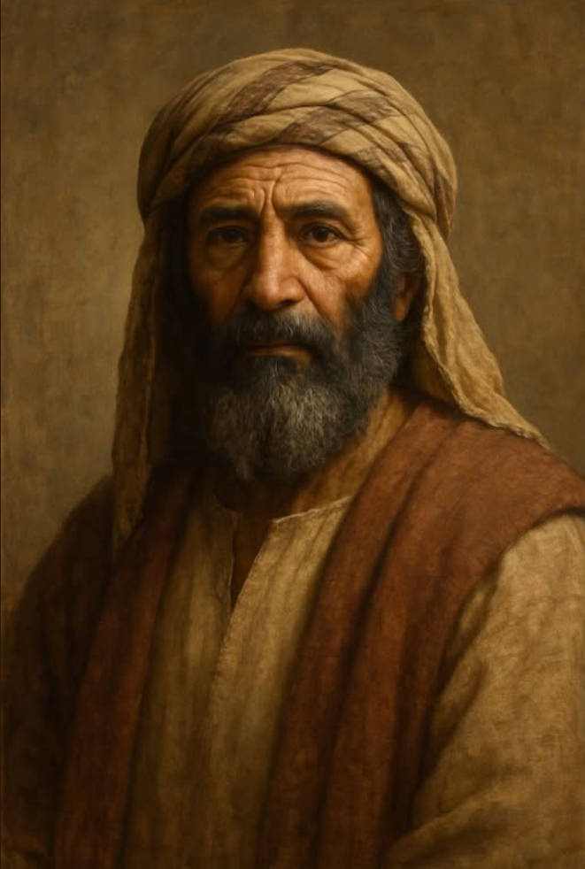
Abraham’s
Great Faith

Slide 3
Abraham Trusted And Obeyed
God required separation (Genesis 12:1)
He obeyed at age 75 (Genesis 12:4)
He was a pilgrim (Genesis 12:6)
He pitched his tent and built an altar (Genesis 12:8)

Slide 4
Like Us, Abraham Was Human
The land of famine (Genesis 12:10)
Problems followed
  Feared for his life
  Selfish thinking
  Hypocritical conduct (Genesis 20)
  Man of world rebuked him (Genesis 12:18)
  Trouble upon others
He called on the name of the Lord

Slide 5
Abraham’s Faith Was Tested
James 1:3
Sacrifice your son
  He did not stagger at the command (Romans 4:20; Heb. 11:19)
  He was prompt in obedience (Genesis 22:3)
  He was deliberate
  He was fully determined (Genesis 22:4)
“Where is the lamb?”
Genesis 22:15-18

Slide 6
Abraham’s
Genesis 19:27-29
Aware of awfulness of sin
God’s punishment
cannot be evaded
Do you trust God?
Great Faith

