Slide 2
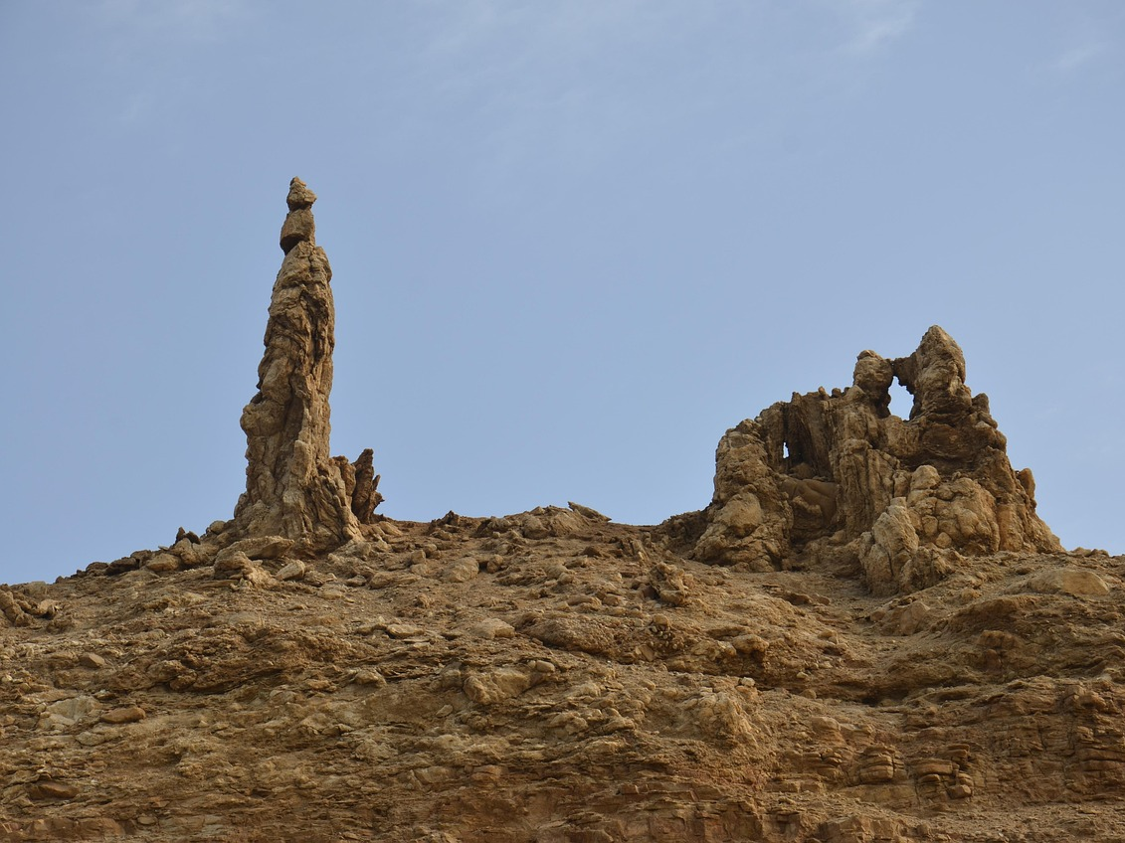
Remember Lot’s Wife
Genesis 19:1-29

Slide 3


Genesis 19:1-29
Homosexuality is sin.
1 Timothy 1:9-10
Romans 1:26-27
1 Corinthians 6:9-11
“such were some of you”
Washed away - Acts 22:16; Ephesians 5:25-27
No spot or wrinkle/sanctified
Romans 3:23 “all have sinned…”

Slide 4
Luke 17:28-32
“when the Son of Man is revealed…”
The end will come suddenly. Luke 17:24
“Remember Lot’s wife”
Luke 9:62 “No one, after putting his hand to the plow and looking back, is fit for the kingdom of God”
Colossians 3:1-2
2 Peter 2:20-22

Slide 5
2 Peter 2:4-10
Genesis 18:20
Lot was “oppressed by the sensual conduct of unprincipled men” and his soul was “tormented day after day by their lawless deeds”
Are we?
Prov. 4:23 “Watch over your heart with all diligence”
Ps. 119:9
Heb. 3:13 “hardened by the deceitfulness of sin”
Matthew 15:18-20
Matthew 24:11-12

Slide 6
Where is your heart?

