Slide 2
Commitment
& Joy
Matthew 22:35-38

Slide 3

Matt. 19:4-6
From Beginning
God Joins
Permanent
Not Selfish
Sacrifice
Eph. 5:25
Nourish/Cherish
Eph. 5:28
Subject
Eph. 5:22
Giving Results In Joy!
Commitment & Joy
In Marriage

Slide 4
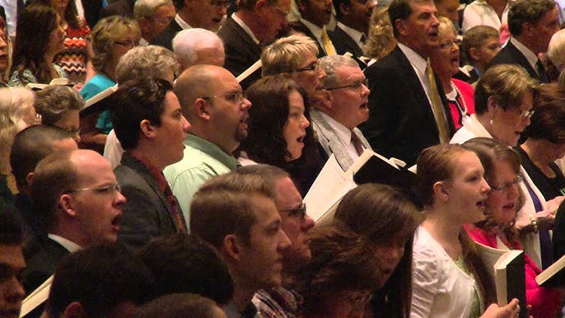
1 John 5:1-2
Demonstrated
Attendance
Them vs Us
Involved
Nourish/Cherish
Abound
1 Cor. 15:58
Giving Results In Joy!
Commitment & Joy
In The Church

Slide 5

Matt. 10:37-39
Before Family
ALL heart, soul,
and mind
What Does
The Evidence Suggest?
Nourish/Cherish
Giving Results In Joy!
1 John 1:3-4
Commitment & Joy
To God

