Slide 2

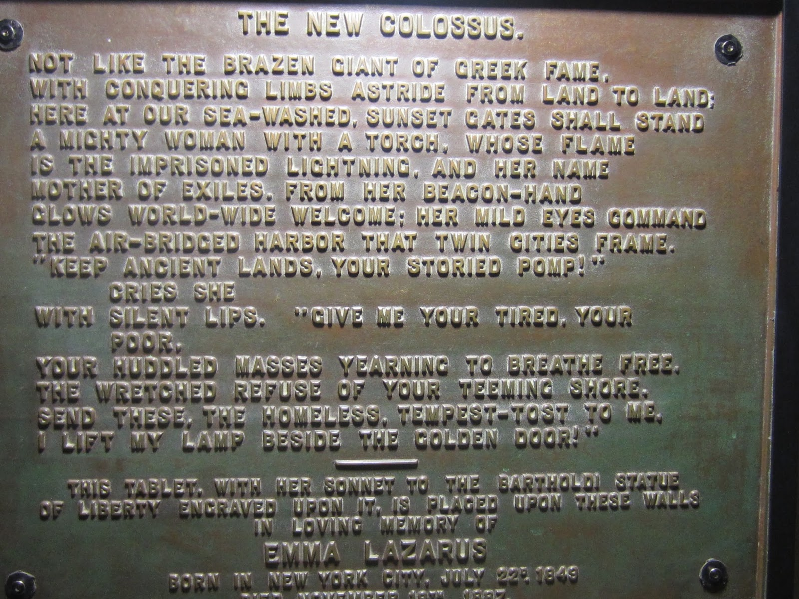

Slide 3

Come To Me
Matthew 11:28-30

Slide 4
Come to Me, all who are weary and heavy-laden, and I will give you rest. Take My yoke upon you and learn from Me, for I am gentle and humble in heart, and you will find rest for your souls. For My yoke is easy and My burden is light. Matthew 11:28-30

Slide 5
Come to Me, all who are weary and heavy-laden, and I will give you rest. Take My yoke upon you and learn from Me, for I am gentle and humble in heart, and you will find rest for your souls. For My yoke is easy and My burden is light. Matthew 11:28-30
An Invitation
God calls us (2 Timothy 1:9)
God calls us through Jesus (John 7:37-39; 6:35-40; 12:44-50)

Slide 6
Come to Me, all who are weary and heavy-laden, and I will give you rest. Take My yoke upon you and learn from Me, for I am gentle and humble in heart, and you will find rest for your souls. For My yoke is easy and My burden is light. Matthew 11:28-30
An Invitation
God calls us (2 Timothy 1:9)
God calls us through Jesus (John 7:37-39; 6:35-40; 12:44-50)
God’s call comes to all men (Romans 3:23)
Weary: to grow weary, tired, exhausted (with toil or burdens or grief)
Heavy-Laden: to place a burden upon, to load

Slide 7
Come to Me, all who are weary and heavy-laden, and I will give you rest. Take My yoke upon you and learn from Me, for I am gentle and humble in heart, and you will find rest for your souls. For My yoke is easy and My burden is light. Matthew 11:28-30
A Promised Gift
Jesus will GIVE it to us (Romans 6:23-24; Ephesians 2:8-9; 2 Cor. 9:15)
More about this “REST” (Hebrews 4:9-11; Acts 3:19)
How does He give us this rest? This is God’s part of salvation. (Luke 22:19; John 3:16; 1 John 5:11)
Ephesians 1:5

Slide 8
Come to Me, all who are weary and heavy-laden, and I will give you rest. Take My yoke upon you and learn from Me, for I am gentle and humble in heart, and you will find rest for your souls. For My yoke is easy and My burden is light. Matthew 11:28-30
A Requirement
What is Christ’s YOKE?
Suffering
Matt. 20:20-23
2 Tim. 2:3
Matt. 5:10
It is a yoke of SERVITUDE

Slide 9
Come to Me, all who are weary and heavy-laden, and I will give you rest. Take My yoke upon you and learn from Me, for I am gentle and humble in heart, and you will find rest for your souls. For My yoke is easy and My burden is light. Matthew 11:28-30
A Requirement
Learn from Me (John 13:15-16; 1 Peter 2:21; 1 John 2:6)

Slide 10
Come to Me, all who are weary and heavy-laden, and I will give you rest. Take My yoke upon you and learn from Me, for I am gentle and humble in heart, and you will find rest for your souls. For My yoke is easy and My burden is light. Matthew 11:28-30
A Requirement
Learn from Me (John 13:15-16; 1 Peter 2:21; 1 John 2:6)
Gentle and Humble
John 4 – woman at well
John 8 – woman in adultery
Phil. 2:5-8

Slide 11
Come to Me, all who are weary and heavy-laden, and I will give you rest. Take My yoke upon you and learn from Me, for I am gentle and humble in heart, and you will find rest for your souls. For My yoke is easy and My burden is light. Matthew 11:28-30
A Requirement
Do we FIND rest or is it GIVEN?
Quote from Jeremiah 6:16
“You will find” From one Greek word:
a. to find by enquiry, thought, examination, scrutiny,
observation, to find out by practice and experience
b. to see, learn, discover, understand
c. to be found i.e. to be seen, be present
d. to be discovered, recognized, detected, to show
one's self out, of one's character or state as found
out by others (men, God, or both)
e. to get knowledge of, come to know, God
f. To find out for one's self, to acquire, get, obtain,
procure

Slide 12
Come to Me, all who are weary and heavy-laden, and I will give you rest. Take My yoke upon you and learn from Me, for I am gentle and humble in heart, and you will find rest for your souls. For My yoke is easy and My burden is light. Matthew 11:28-30
A True Perspective
Some strange attitudes: Impossible to fully obey
Too Restrictive
Cruel or Mean
Compared with Old Covenant
In Light of the Judgment to come

Slide 13
Come to Me, all who are weary and heavy-laden, and I will give you rest. Take My yoke upon you and learn from Me, for I am gentle and humble in heart, and you will find rest for your souls. For My yoke is easy and My burden is light.
The Gospel Encapsulated In Three Verses
Are you weary and heavy-laden as a result of sin?

