Slide 2
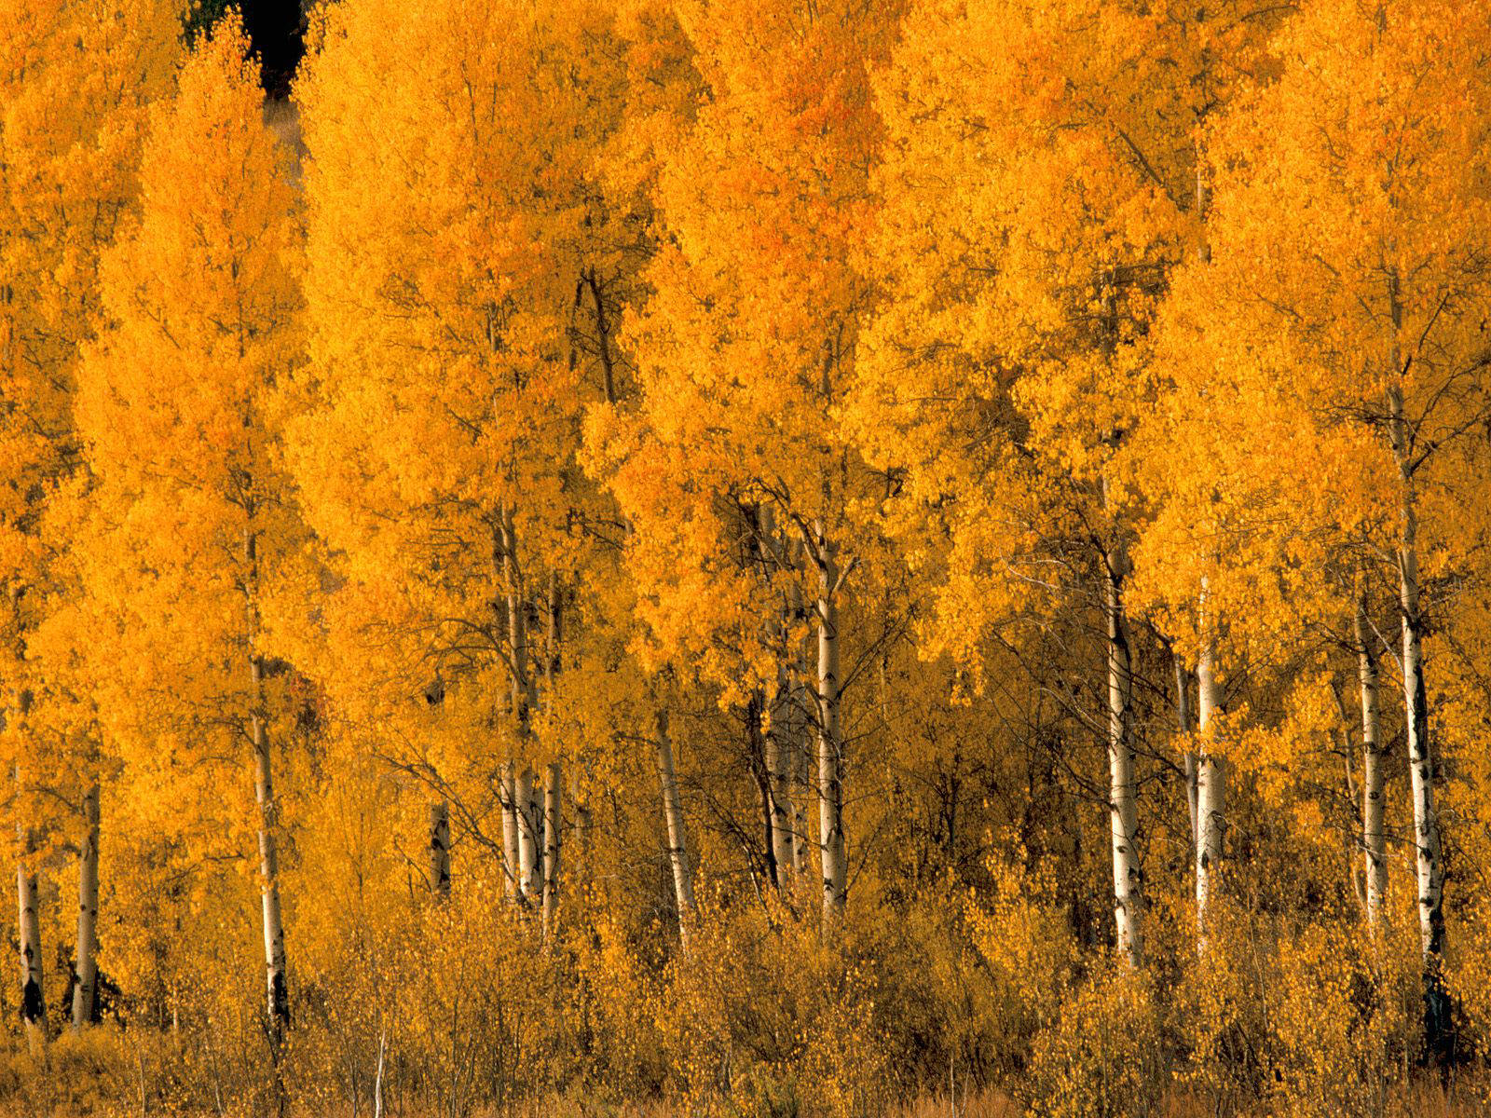
Fleeing
And
Pursuing
2 Timothy 2:20-26

Slide 3
Flee Youthful Lusts
“to flee away, seek safety by flight”
Sexual Temptations (1 Tim. 4:12)
Quick Tempered
Sharp Tongued
Worldly & Empty Chatter (v.16)
Foolish/Ignorant Speculations (v.23)

Slide 4
Things To Pursue (2 Tim. 2:22)
PURSUE is the opposite of FLEE
Pursue Righteousness
Pursue Faith (2 Tim. 3:14)
Pursue Love (2 Tim. 2:24-26; 3:3)
Pursue Peace (Col. 1:20; 3:15; Eph. 4:3; Rom. 14:7; 1 Thess. 5:13)

Slide 5
1 Timothy 6:9-11
What Are You Fleeing?
What Are You Pursuing?

