Slide 2
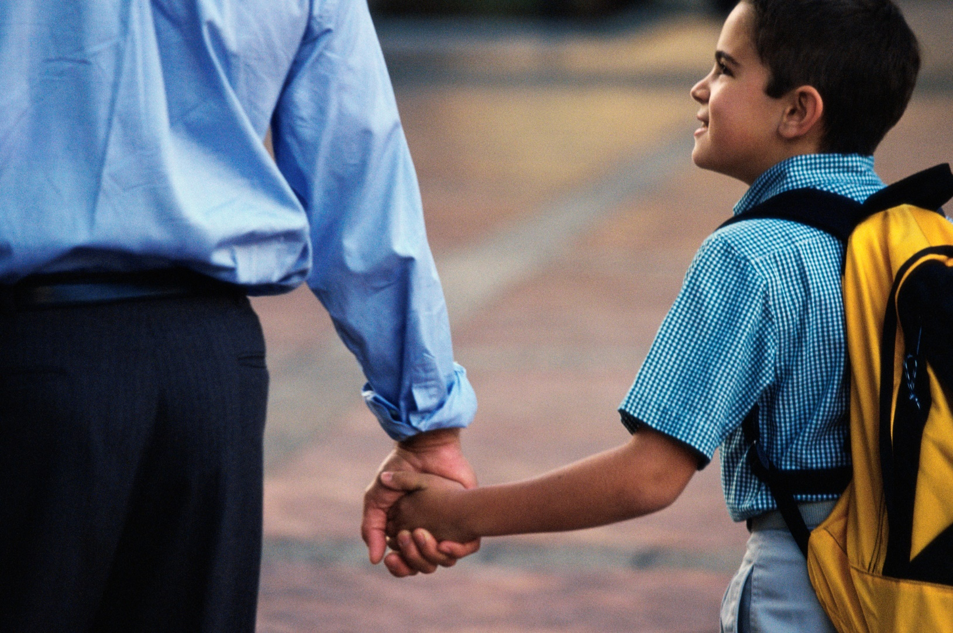
Honoring Our Father

Slide 3

Honor Father & Mother (Ex. 20:12)
Ephesians 6:1-3
How do we honor them?
A truth God recognizes, one we recognize on Father’s Day
“A Son Honors His Father” (Mal. 1:6)

Slide 4
A look at the context…
Consequences (Mal. 2:1-9)
Romans 13:7 “honor to whom honor due”
1 Tim. 1:17 To Him be glory & honor forever and ever.
“Then, if I am a Father, where is My honor”? (Mal. 1:6)

Slide 5
“A Son Honors His Father” (Mal. 1:6)
How do we honor God?
Romans 1:21-23 obedience
1 Cor. 6:19-20 in our body
Prov. 3:9 from your wealth
Prov. 14:31 gracious to needy
“Then, if I am a Father, where is My honor”? (Mal. 1:6)

Slide 6
“A Son Honors His Father” (Mal. 1:6)
1. When we honor with lips? (Matt. 15:3-9 )
2. When we follow tradition? (John 4:24; Col. 3:16; Eph. 5:19)
3. When we show partiality? (Mal. 2:9; Gal. 5:3)
4. When we say “everyone who does evil is good”? (Mal. 2:17)
“Then, if I am a Father, where is My honor”? (Mal. 1:6)

Slide 7
“A Son Honors His Father” (Mal. 1:6)
“Then, if I am a Father, where is My honor”? (Mal. 1:6)
When I don’t attend assemblies…
When I don’t bring up my children in nurture and admonition of the Lord…
When I don’t give as I’ve been prospered…
When I don’t encourage others…
When I don’t keep myself pure…

Slide 8
“A Son Honors His Father” (Mal. 1:6)
“Then, if I am a Father, where is My honor”? (Mal. 1:6)
Malachi 3:16-18
1. When we honor with lips?
2. When we follow tradition?
3. When we show partiality?
4. When we say “everyone who does evil is good”? (Mal. 2:17)
5. When we do not observe the Lord’s Supper (John 5:23)

Slide 9
Are We
Honoring Our Father
Malachi 3:16-18

