Slide 2
The Tools Of Resistance
Ephesians 6:10-18

Slide 3
Why Is The Gospel Armor Given?
“That you will be able to stand firm against the schemes of the devil” (v.11)
“to stand firm” (v.13)
“in the evil day” (v.13)
Satan would knock us down!

Slide 4
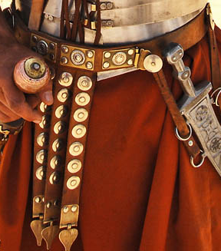
Loins Gird With Truth
We must be totally convicted of truth
Spiritual vision is not clouded
2 Corinthians 13:5
Eph. 6:14
RESIST

Slide 5
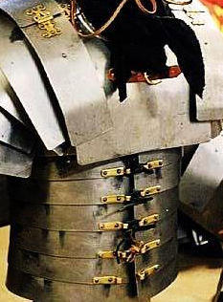
Breastplate of Righteousness
Protects the heart
To Do Right & Be Right
Gaps in the armor
Righteous habits
Eph. 6:14
RESIST

Slide 6
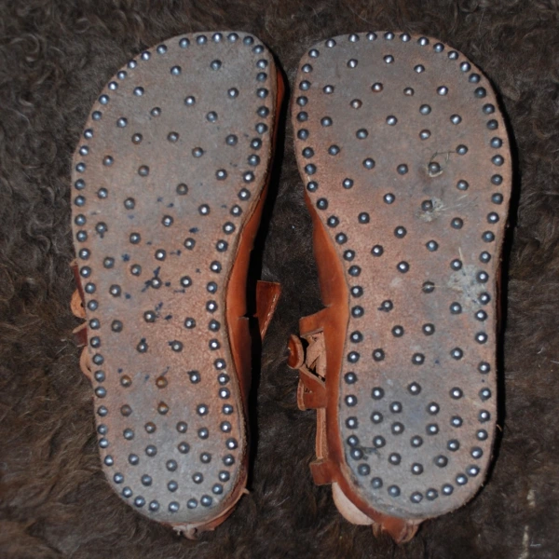
Feet Shod With
Preparation of Gospel
Provides firm footing
Preparation is key to defense against Satan
Gospel gives sure footing in the “evil day”
Resistance does no good without sure footing
Eph. 6:15
RESIST

Slide 7
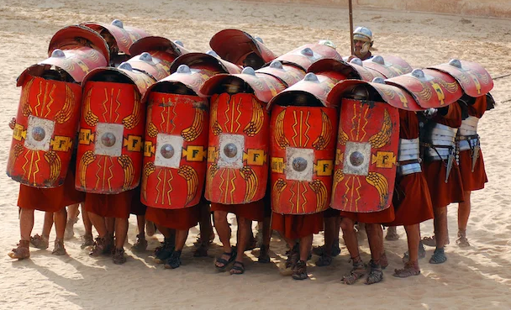
Shield Of Faith
A defensive tool – varying sizes
Spiritual shields should grow
Faith must be constant
We can extinguish the flaming arrows of Satan
Eph. 6:16
RESIST

Slide 8
Helmet of Salvation
Represents our hope!
John 14:2-3
Don’t lose sight of salvation in the midst of the battle
Eph. 6:17
RESIST

Slide 9
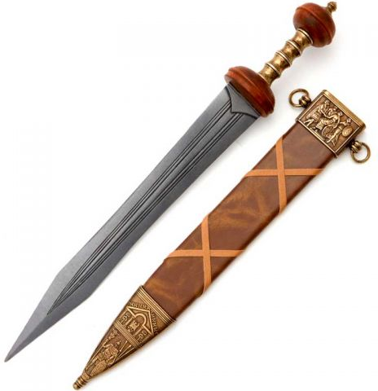
Sword Of The Spirit
Offensive & Defensive
Jesus’ Temptations
Passages should ring out when tempted
Eph. 6:17
RESIST

Slide 10
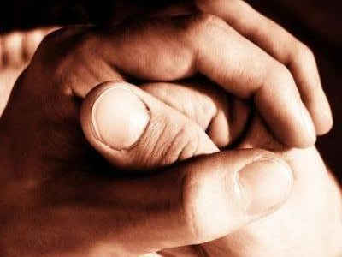
Praying Always
No illustrative piece of armor
Ask for help when under attack
Cultivate prayer!
Eph. 6:18
RESIST

Slide 11
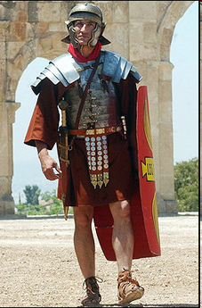
The Tools Of Resistance
Personal Honesty
Doing Right, Being Right
Grounded In Word
Believe
Keep Hope Alive
Know God’s Word
Pray Always
The Gospel Armor
RESIST

