Slide 2
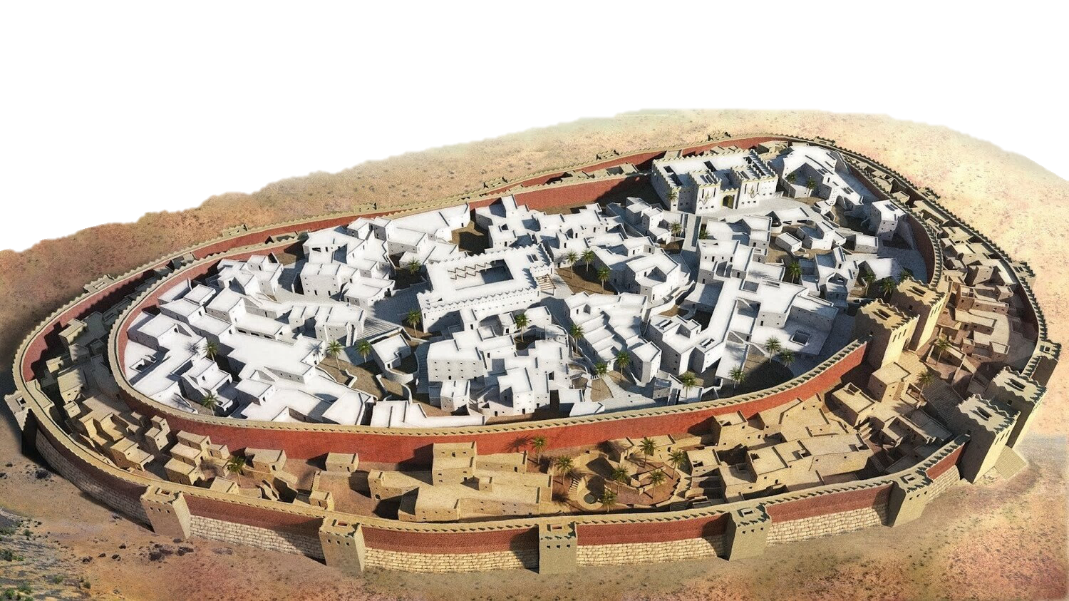
the siege of
JERICHO
Joshua 6:1-21

Slide 3

Jericho was a doomed city!
Under the curse of God (Deut. 20:16-18)
A fight between righteousness and idolatry
How many are doomed individuals today?

Slide 4
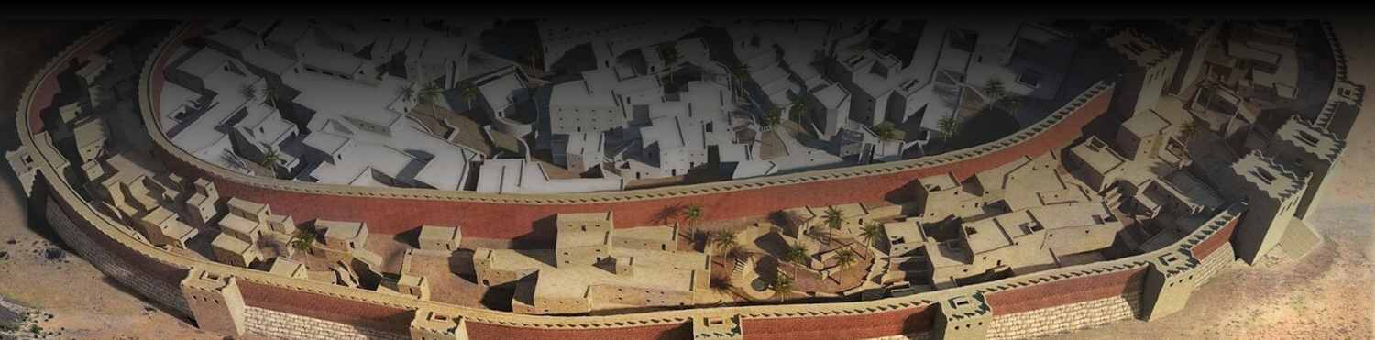
Given An Difficult Task!
Take the city of Jericho!
We feel God’s task are difficult.
Difficulty does not change duty!
Believe Matthew 19:26

Slide 5
God Destroys The Wicked
In Jericho (Joshua 6:26)
This has always been God’s attitude
God has not changed (Romans 6:23)
Seek the Lord now (2 Peter 3:10-11)

