Slide 2
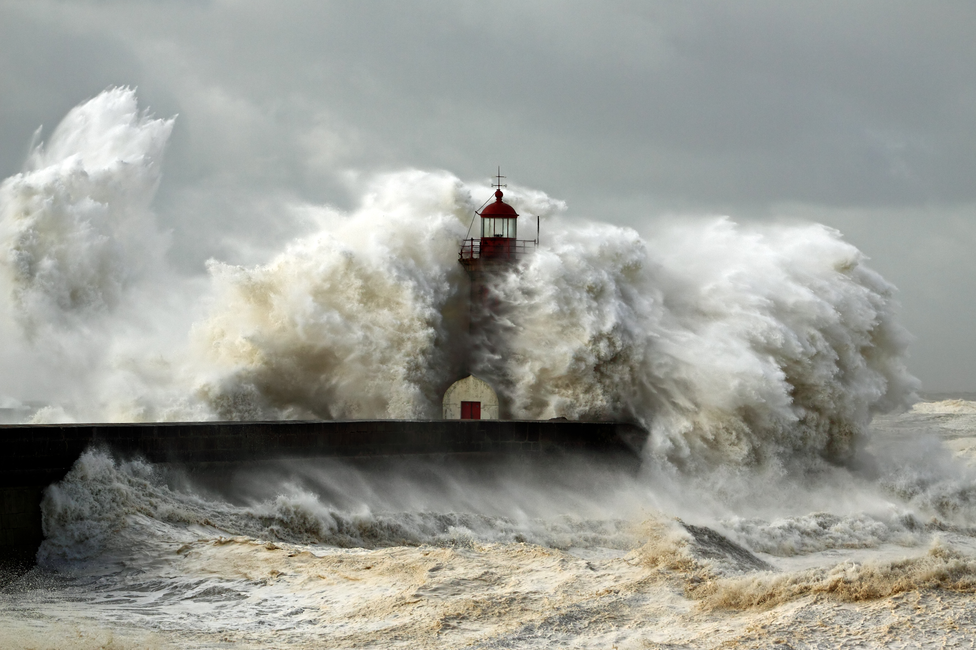
BUILD ON
THE ROCK

Slide 3
Two Gates (Matthew 7:13-14)
Be very concerned! Few find it!
Modern “Christianity” in our country has reversed what Jesus said. (2 Timothy 4:3; 2 Thessalonians 1:8-9)
Why are people on the Broad Way? (Hosea 4:6)
BUILD ON THE ROCK

Slide 4
Two Gates (Matthew 7:13-14)
How narrow is the narrow way?
Hear & Believe (Eph. 1:13; John 5:24; Acts 4:4; Rom. 10:14)
Confess Jesus (Rom. 10:9-10; Matt. 10:32-33)
Repent (Acts 17:30; 2 Cor. 7:10)
Baptized (Mark 16:16; Acts 22:16; Acts 2:38)
Live Faithful (Phil. 1:27; Eph. 4:1-3, 17, 19)
BUILD ON THE ROCK

Slide 5
The Tree & Fruit (Matthew 7:15-20)
Be careful to hear and believe the truth!
How to know who is the false teacher: their fruits.
(1 Timothy 4:1-4; Gal. 1:7; Acts 20:27; Acts 17:11)
BUILD ON THE ROCK

Slide 6
Entering The Kingdom (Matthew 7:21-23)
Many on the “broad way” say “Lord, Lord.”
Doing things “in Jesus’ name” does not insure my salvation (1 Cor. 9:27; 13:1-3)
“I never knew you; Depart from Me”
The danger of self-deception!
(Luke 6:15; 1 Cor. 3:18; Gal. 6:3; James 1:26)
BUILD ON THE ROCK

Slide 7
CONCLUSION
God’s word is given through Christ (John 8:28; 12:48-50)
Matthew 7:28-29 the authority of Christ.
Are you building on the rock?
Are you on the broad or narrow way?
Are you foolish or wise?
WHAT WILL YOU CHOOSE?
BUILD ON THE ROCK

