Slide 2
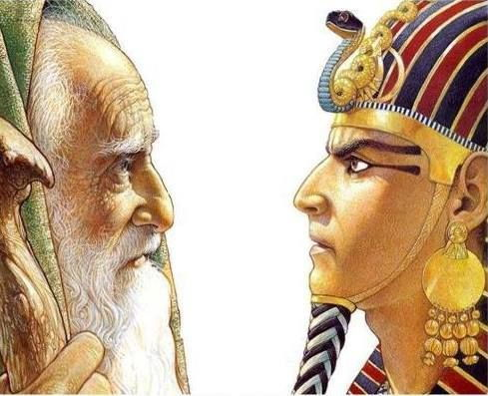
Who Is The Lord That I Should Obey His Voice?
Exodus 4:29-5:2

Slide 3
Who Is The Lord That I Should Obey His Voice?
He Is God
He Is Creator
He Is The Giver Of Life
From Everlasting To Everlasting
He Is All Powerful
He Is All Knowing
He Is The Redeemer

Slide 4
Who Is The Lord That I Should Obey His Voice?
APPLICATIONS
Written For Our Learning (Rom. 15:4; 1 Cor. 10:11)
Respect & Reverence (Hebrews 12:28-29)
God Created Us
He Is Eternal, All Powerful, All Knowing, Our Ruler
He Is Our Redeemer (1 Pet. 1:18-19; Rom. 3:24)

Slide 5
Who Is The Lord That I Should Obey His Voice?
Do You Know The Lord?
Have You Obeyed His Voice?

