Slide 2
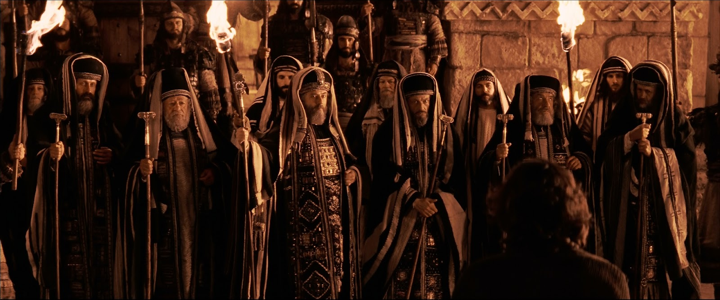
Can You See Jesus?
Luke 18:3-33

Slide 3
Trials
Jesus Was Betrayed
By the council (John 7:1; 8:37)
By Judas (Matthew 26:14-16)
Illegal Jewish Trial
Middle of night (John 18:12-22; Matthew 26:57-68)
Beaten by Scribes and Priests (Luke 22:65)

Slide 4
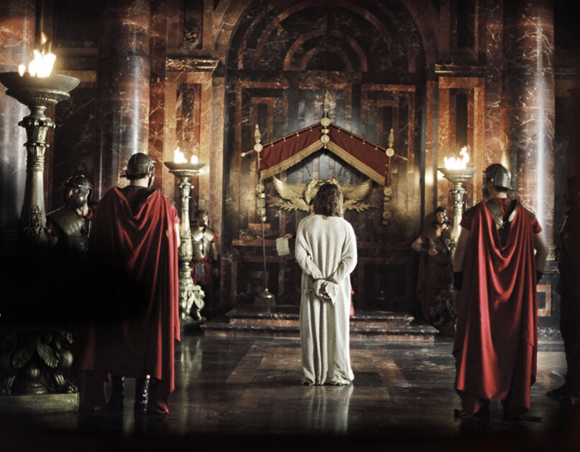
Roman Trials
Pilate
Charges (John 18:30; Luke 23:2)
One on one (John 18:33-38)
Pronounced innocent (Luke 23:4)
Herod (Luke 23:6-12)
Barabbas Released (Luke 23:20-24)

Slide 5
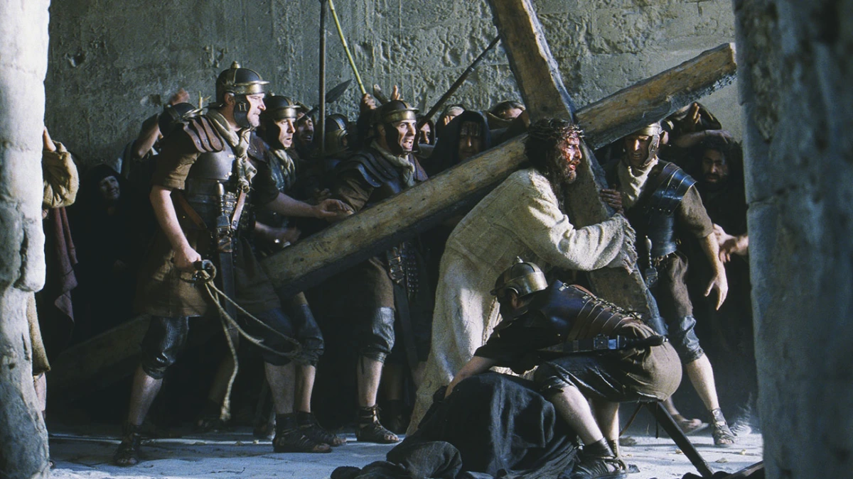
The Sufferings Of Christ
Scourged (Matthew 27:26)
Crown of Thornes (John 19:4-16)
Carried His Own Cross (John 19:17)

Slide 6
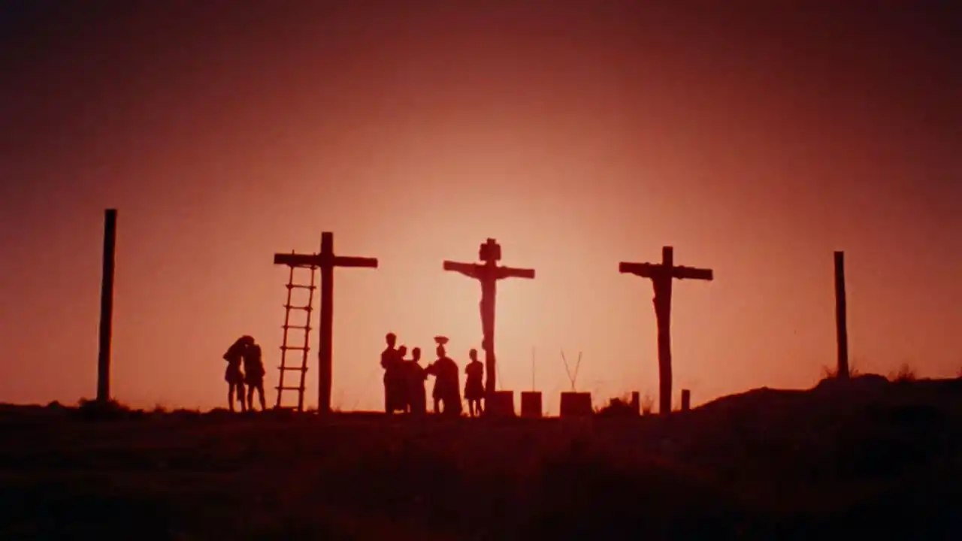
The Crucifixion
The Third Hour (Mark 15:25)
Nails in Hands and Feet
Death By Suffocation
Sixth Hour (darkness – Mark 15:33)
Ninth Hour (Mark 15:34; Luke 23:46)

Slide 7
Can You See Jesus?
He suffered that all men might be made free from sin (1 Timothy 2:4; 2 Peter 3:9)
Salvation is only through Jesus (2 Timothy 1:10; Hebrews 2:9)
Will you give your life to Jesus?

