Slide 2
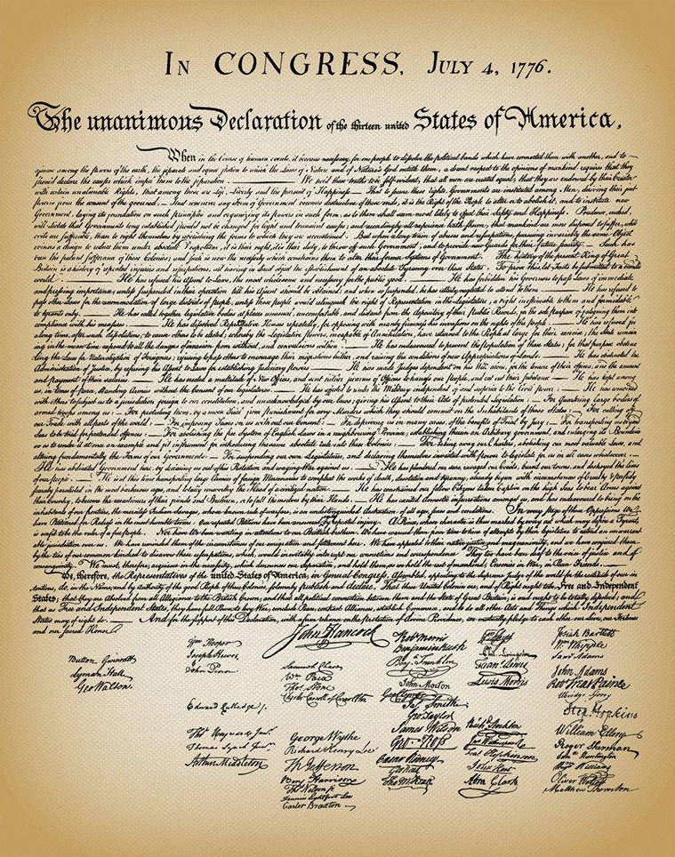
Living Free

Slide 3
Freedom In Christ
Luke 4:16-22
The Spirit of the Lord is upon Me
Because He anointed Me to preach
the gospel to the poor
He has sent Me to proclaim release to the captives.
To se free those who are oppressed.
To proclaim the favorable year of the Lord.

Slide 4
Freedom In Christ
Romans 7:21-25
Romans 8:2
Hebrews 2:14-18
Galatians 2:3-5
Revelation 1:5

Slide 5
Freedom From Law Of Moses
Acts 13:38-39
(Hebrews 9:9-14; 10:1-4; 10:11-14)
Galatians 5:1-7

Slide 6
Freedom From Penalty Of Sin
Romans 6:16
Romans 6:12
Romans 6:5-7
Romans 6:17-18
Romans 6:22
John 8:31-36
(John 17:17; 1 John 1:7)
James 1:25
James 1:22

Slide 7
Live As A Free Man!
1 Peter 2:16
1 Timothy 5:22
Hebrews 10:26
Galatians 5:13-15

Slide 8
Are You Living Free?
Are you ready for
Christ to set you free?
Have you put on
the yoke of sin again?

