Slide 2
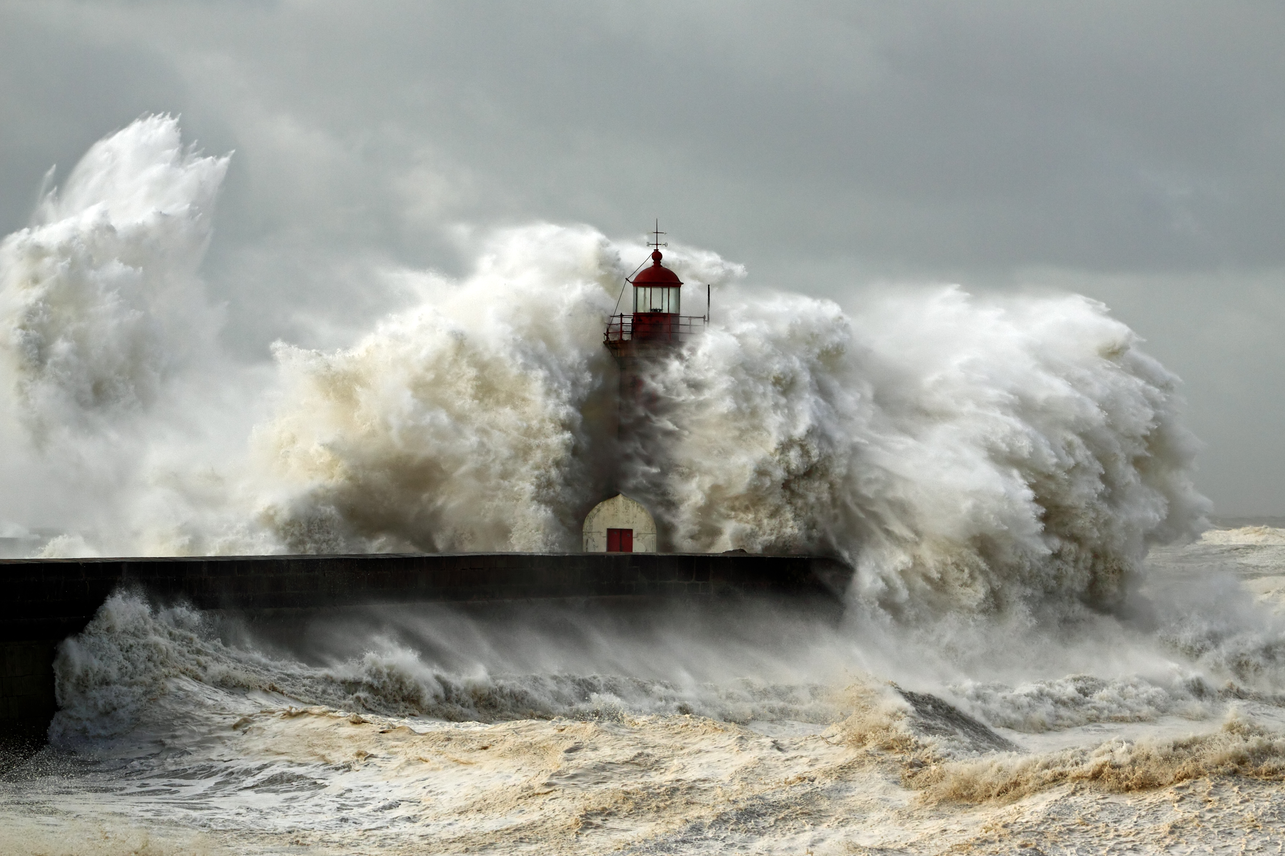
BUILD ON
THE ROCK

Slide 3
Beware (Matthew 6:1)
Practicing righteousness to be seen by men
“You have no reward with your Father who is in heaven”
BUILD ON THE ROCK

Slide 4
Giving To The Poor (Matthew 6:2-4)
A good deed we are to do (James 1:27; Eph. 4:28; Gal. 2:10; 1 John 3:17; Gal. 6:10)
A proper attitude and motivation. Not like the hypocrite.
Sounding a trumpet (Matt. 6:2)
BUILD ON THE ROCK

Slide 5
Praying (Matthew 6:5-8)
Public prayer (Matt. 14:19; John 17; Acts 1; Acts 4:31)
Not like the hypocrites (Matt. 23:14)
Praying in secret
Matthew 6:7-8 (Meaningless Repetitions)
BUILD ON THE ROCK

Slide 6
The Model Prayer (Matthew 6:9-13)
Pray in this way…
To the Father whose name is hallowed.
God’s will be done.
Our daily bread.
Our need for forgiveness (Heb. 4:16; 1 John 1:9)
Do not lead us into temptation, but deliver us…
BUILD ON THE ROCK

Slide 7
Fasting (Matthew 6:16-18)
Not a command for Christians. Many examples of voluntary fasting. (2 Sam. 12:16ff; Esther 4:3, 16; Jonah 3:6ff; Acts 13:1ff; Acts 14:23
Fasting with a proper attitude and motivation.
BUILD ON THE ROCK

Slide 8
CONCLUSION
Do we hear and act
on these words of Jesus?
Are we building on the rock?
BUILD ON THE ROCK

