Slide 2



3 Arguments
Historical
Absence In Scripture
Scriptural Proof
MUSIC
IN
WORSHIP

Slide 3
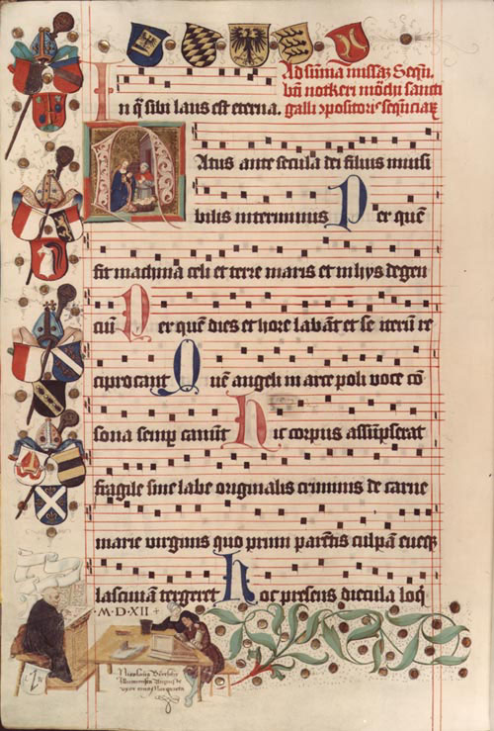
History of Western Music (Grout)
“Hymn singing is the earliest recorded musical activity of the Christian church”. (p.13)
The early church “excluded music from the public worship” (p.26)
“The organ does not seem to have been used regularly with the choir in Mass much before the 13th century” (p.64)
The Historical Argument

Slide 4
Encyclopedia Judaica
“Jingling, banging, and rattling accompanied heathen cults…The voices of nonconformists were emerging from place of Jewish and early Christian worship. Early synagogue song intentionally foregoes artistic performance, renounces the playing of instruments, and attaches itself entirely to ‘the word’”. (XII, p.566)
The Historical Argument

Slide 5
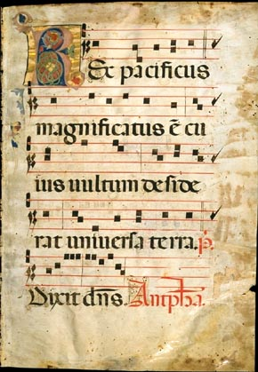
The Historical Argument
Catholic Encyclopedia
“For almost 1000 years, Gregorian Chant without any instrumental or harmonic addition, was the only music used in connection with liturgy.” (X, p.657)

Slide 6
The Historical Argument
New Catholic Encyclopedia
“The rejection of all musical instruments for the Christian worship is consistent among the Fathers (meaning church fathers). They were associated with pagan, orgiastic rites” (X, p.106)

Slide 7
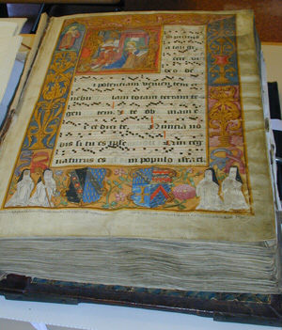
The Historical Argument
New Oxford History Of Music
“…instrumental music was thought unfit for religious services; the Christian sources are quite outspoken in their condemnation of instrumental performances…” (I, p.135)

Slide 8
The Historical Argument
Wycliff Bible Encyclopedia
“There is no record in the New Testament of the use of instruments in the music worship of the church…” (p.1163)

Slide 9
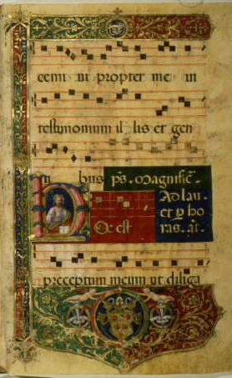
The Historical Argument
A History Of The Christian Church
“Singing formed an essential part of the Christian worship, but it was in unison and without musical accompaniment.” (p.112)

Slide 10
The Historical Argument
The American Encyclopedia
“ The church although lapsing more and more into defection from the truth and into a corruption of apostlic practice had no instrumental music for 1200 years…”

Slide 11
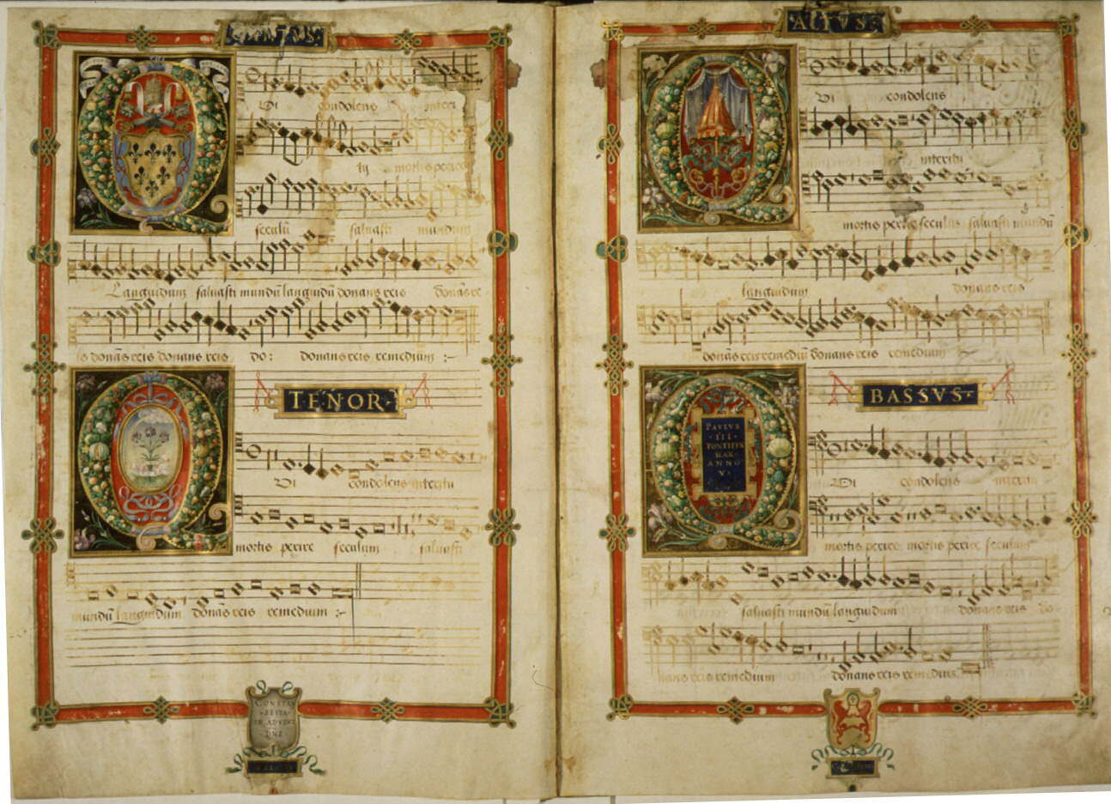
The Historical Argument
Religious Leaders
Tertullian (AD 160-230)
“ …ye who are Christians, hate and abhor these things…”
Thomas Aquinas (AD 1225-1275)
“Our church does not use musical instruments…”

Slide 12
The Historical Argument
Religious Leaders
John Calvin (AD 1509-1564)
“ …musical instruments in celebrating the praises of God would be no more suitable than the burning of incense…”
Charles Spurgeon (AD 1834-1892)
“We do not need them…”

Slide 13
The Historical Argument
Religious Leaders
Adam Clark
“ …but instrumental music in the house of God I abominate and abhor…”
John Wesley
“I have no objection to the instruments in our chapel, provided they are neither seen nor heard”

Slide 14
The Historical Argument
Instruments did not become an accepted practice till the 13th century.
Why did people oppose their use and why do people accept their use now?

Slide 15
The Absence In Scripture Argument
God had to authorize in speech what the Israelites were to do (Ex. 22:28; Lev. 24:12; and Ex. 31:14-15; Numb. 15:32-34)
2 John 9
Principle found in the New Testament (Heb. 7:14)
Everything does not need a “thou shalt not”!
Instrumental Music in worship is not acceptable to God.

Slide 16
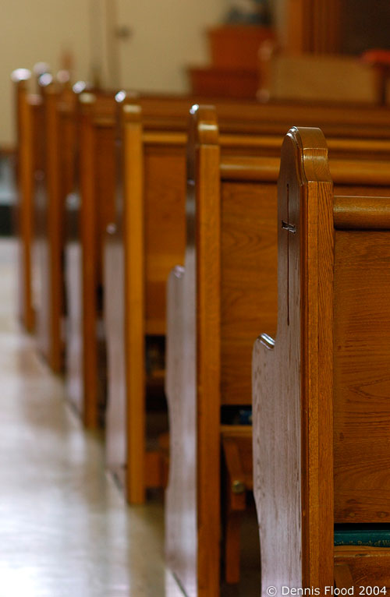
The Scriptural Argument
N.T. Verses Regarding Music In Worship
Ephesians 5:19
Colossians 3:16
1 Corinthians 14:16
Romans 15:9-10
Hebrews 2:12
James 5:13

Slide 17
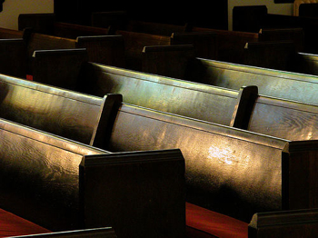
Speak To One Another (Eph. 5:19)
Teaching & Admonishing One Another (Col. 3:16)
“Sing” is Specific
The Scriptural Argument
David used harps, so can we?
  2 Chronicles 29:25
  Galatians 5:2
  God did not specify instruments today

Slide 18
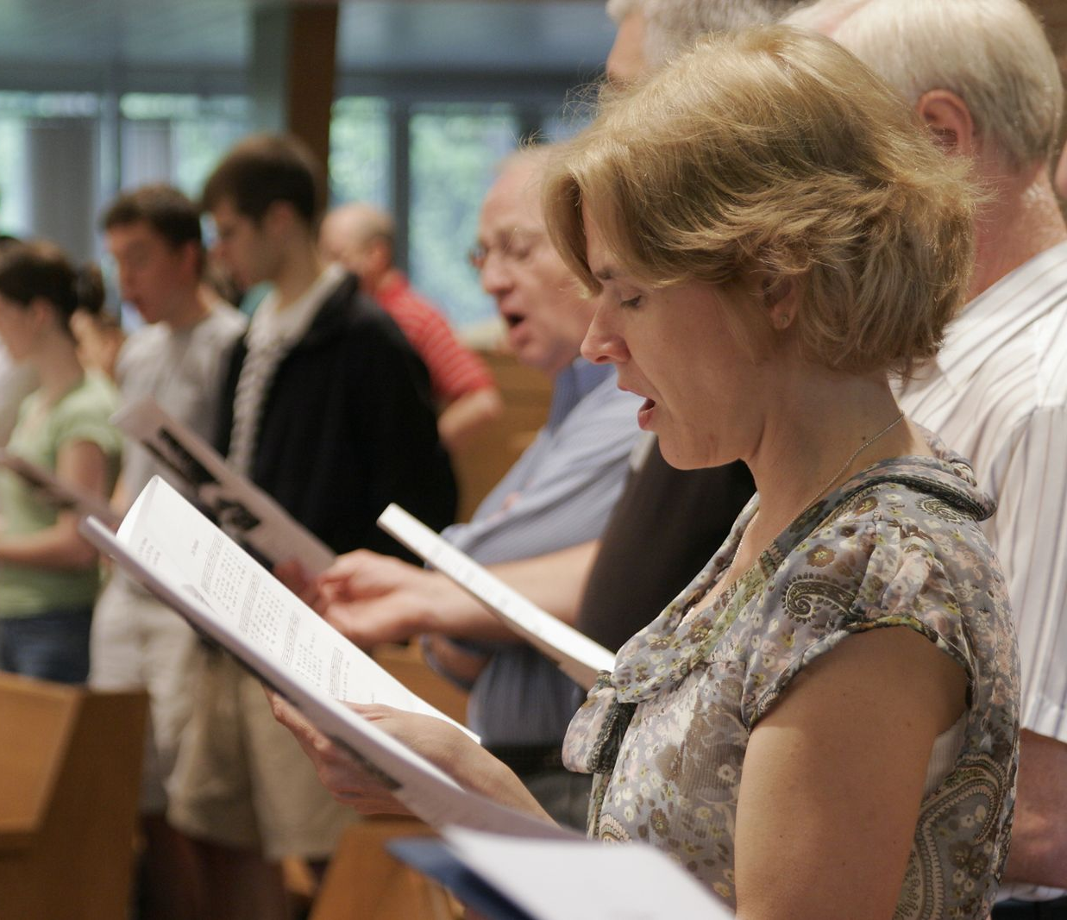
We Sing Accapella
We obey John 4:24
We sing with grace in our hearts (Col. 3:16)
These are God’s desires.

