Slide 2
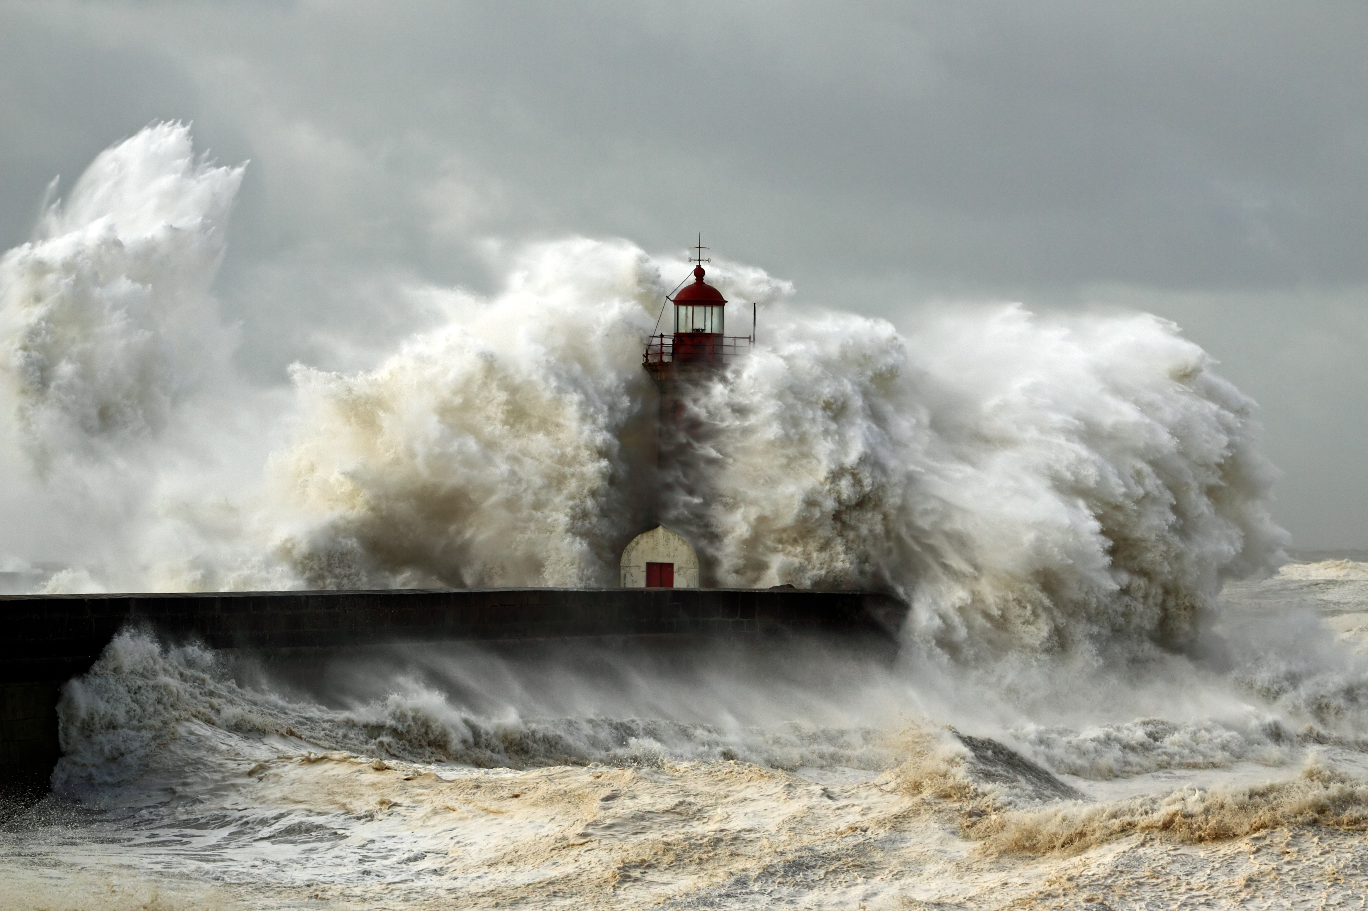
BUILD ON
THE ROCK

Slide 3
Vows/Oaths (Matthew 5:33-37)
You have heard… (Numbers 30:2; Deuteronomy 23:21-23; Leviticus 19:12; Matthew 23:16-22)
“Make no oath at all” (Matthew 12:36-37)
Let your statement be yes or no (Hebrews 6:16; Colossians 3:9; Ephesians 4:14,25)
BUILD ON THE ROCK

Slide 4
Personal Righteousness (Matthew 5:38-42)
“An eye for an eye…” (Deut. 19:19-21; Ex. 21:22)
“Do not resist an evil person” (Romans 12; 1 Thess. 5:15; 1 Peter 3:9; Romans 13:1-7)
Three examples (5:39-41)
Turn the other cheek – leave vengeance to God
Give him coat also – abandon civil rights (1 Cor. 6:7)
Go 2 miles – Matt. 27:32 – Do more than expected
Give to him who asks
BUILD ON THE ROCK

Slide 5
Love Like The Father (Matthew 5:43-48)
What they heard (Leviticus 19:18; Luke 10:29ff)
The Father is our standard
1 John 4:7-11, 19
Luke 6:35
Matthew 18:22-22
BUILD ON THE ROCK

Slide 6
CONCLUSION
Do we hear and act
on these words of Jesus?
Are we building on the rock?
BUILD ON THE ROCK

