Slide 2
The Ten Virgins
Matthew 25:1-13

Slide 3
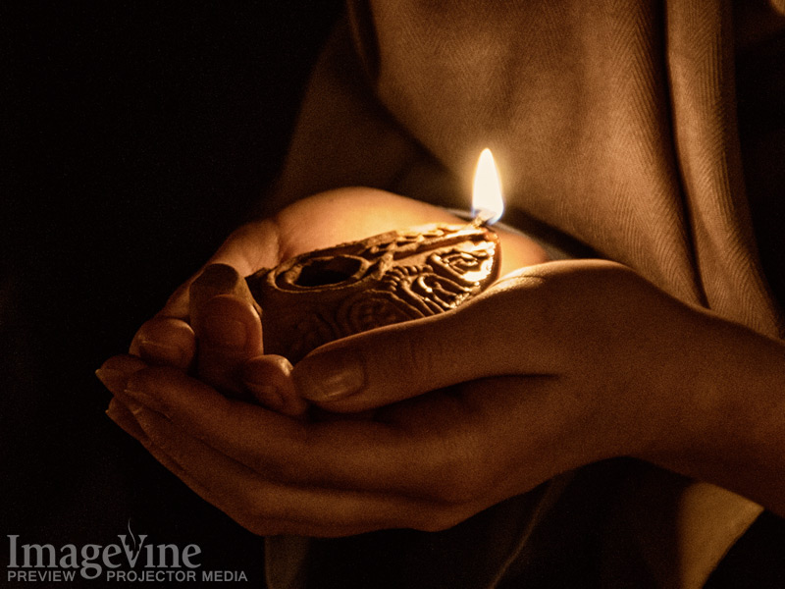
About The Kingdom Of Heaven
Symbolism of Marriage
Romans 7:4
John 3:29
Ephesians 5:25-32

Slide 4
The Foolish
Inadequately Prepared
Last minute preparations
Allowed lamps to go out
Not AWARE until too late
Negligence
Doing minimum

Slide 5
The Wise
Knew their state of preparedness
Each is responsible for their own soul
“buy for ourselves” (v.9)
Those ready “went in with Him” (v.10)
Who is ready?
“The door was shut” (v.10)

Slide 6
Application
Watch!
1 Thessalonians 5:2-10
Revelation 3:1-3
Mark 14:38
Luke 21:34-36

Slide 7
Be prepared & Watchful
Are you ready for the Lord’s return?

