Slide 2
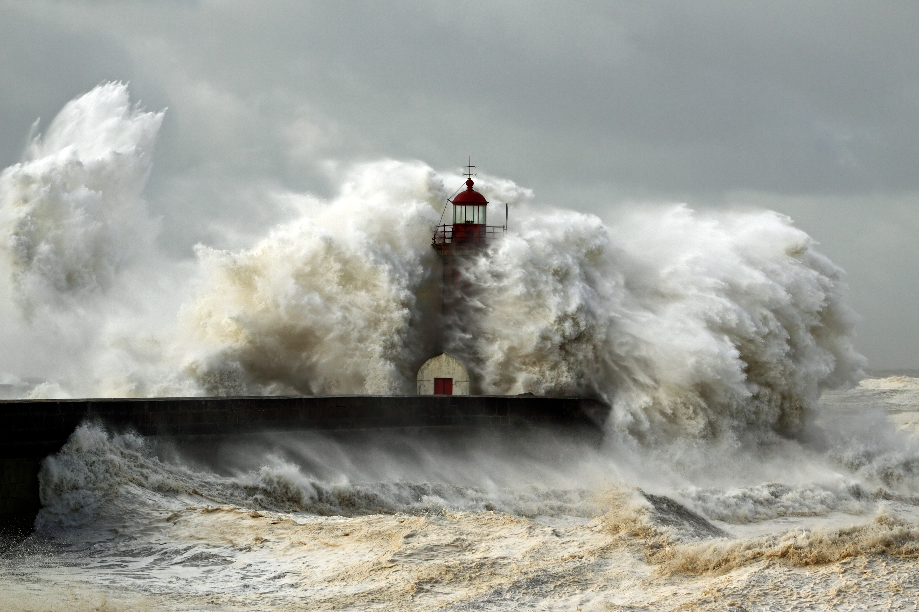
BUILD ON
THE ROCK

Slide 3
Blessed (Matthew 5:1-12)
5:3 The poor in spirit
5:4 Those who mourn
5:5 The gentle
5:6 Those who hunger and thirst for righteousness
5:7 The merciful
5:8 The pure in Heart
5:9 The peacemakers
5:10-12 The persecuted
BUILD ON THE ROCK

Slide 4
Matthew 5:13-16
Salt and Light
The Lamp is to shine on “all who are in the house.” Be a godly influence in the home.
The Light of the World. Be a godly influence on those outside the home.
BUILD ON THE ROCK

Slide 5
CONCLUSION
Revelation 14:13
Do we hear and act
on these words of Jesus?
BUILD ON THE ROCK

