Slide 2
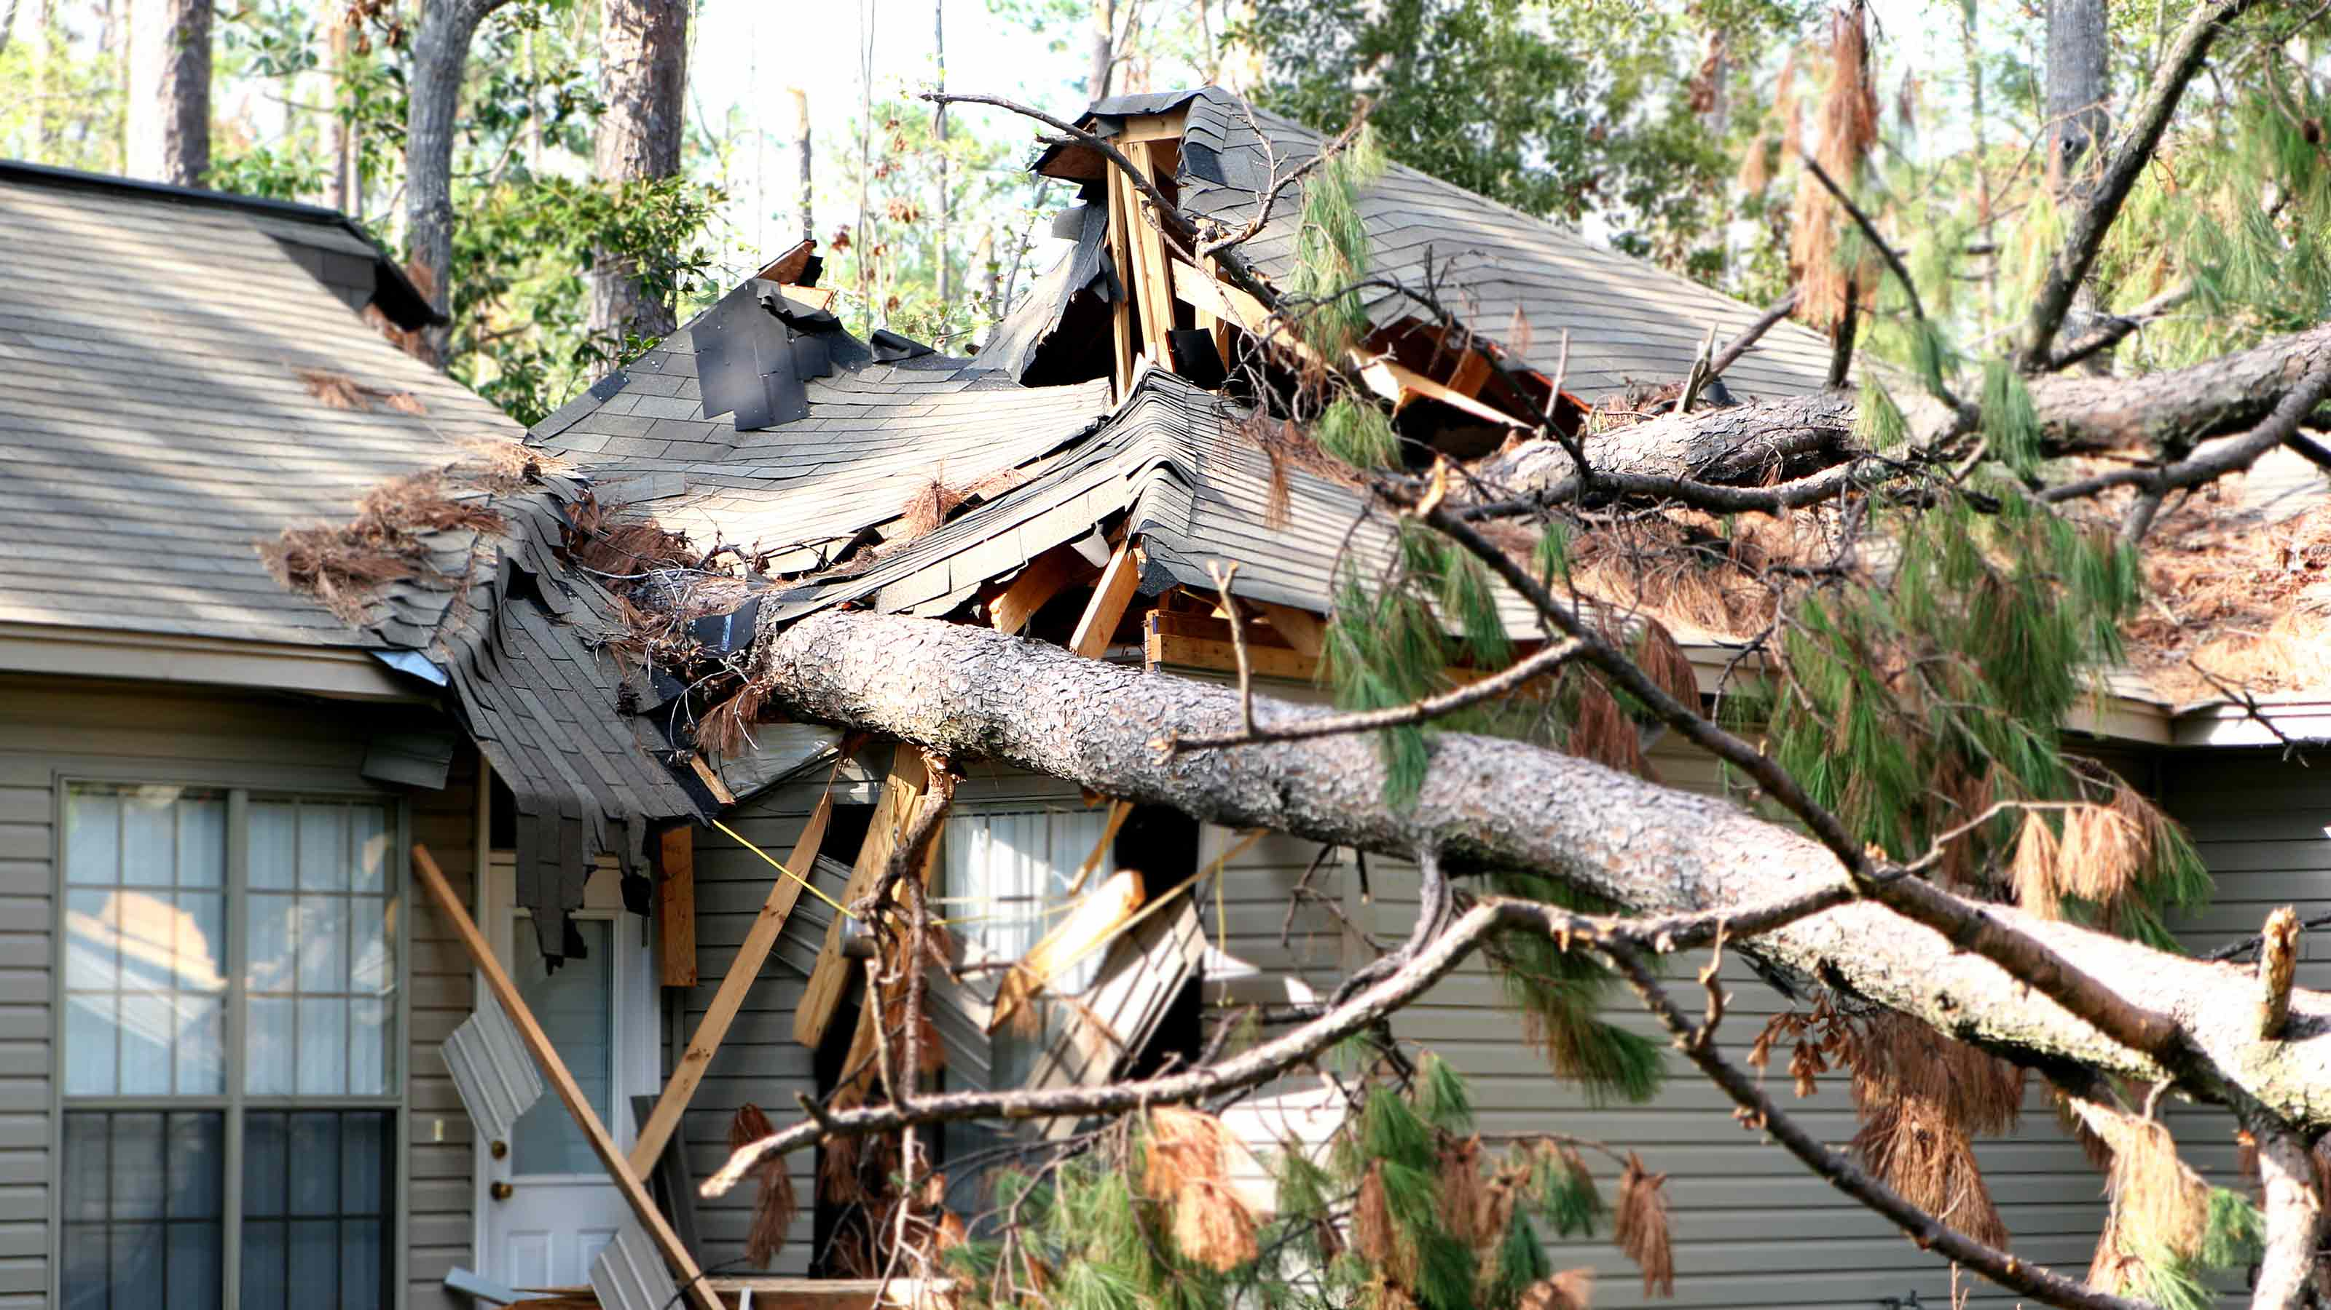
God Uses Problems

Slide 3
To Direct Us
Pharaoh (Exodus 5:1, 22-23)
Adversity gets our attention focused on God.
Proverbs 20:30 “stripes that wound scour away evil, and strokes reach the innermost parts”
Hebrews 4:16
God Uses Problems

Slide 4
To Inspect Us
Judges 2:11-22 (Israel)
Genesis 22:10-13 (Abraham)
Deuteronomy 8:1-2 (Israel)
James 1:2-4 (Us)
1 Peter 1:6-7 (Us)
God Uses Problems

Slide 5
To Correct Us
Hebrews 12:4-11
Psalm 119:71 “It is good for me that I was afflicted, that I may learn Your statutes…”
Some will rebel (Acts 26:14; James 4:6-7)
1 Corinthians 11:29-32
Revelation 3:19
God Uses Problems

Slide 6
To Perfect Us
1 Peter 1:7 (Zechariah 13:9; Isaiah 48:10)
Problems help us learn what is important (Romans 5:3-5; 1 John 5:19; Matthew 6:33)
2 Corinthians 12:7-10
God Uses Problems

Slide 7
Conclusion
God Uses Problems
To Direct Us
To Inspect Us
To Correct Us
To Perfect Us
2 Corinthians 4:7-18
Romans 8:28
Are you overcome by problems?

