Slide 2
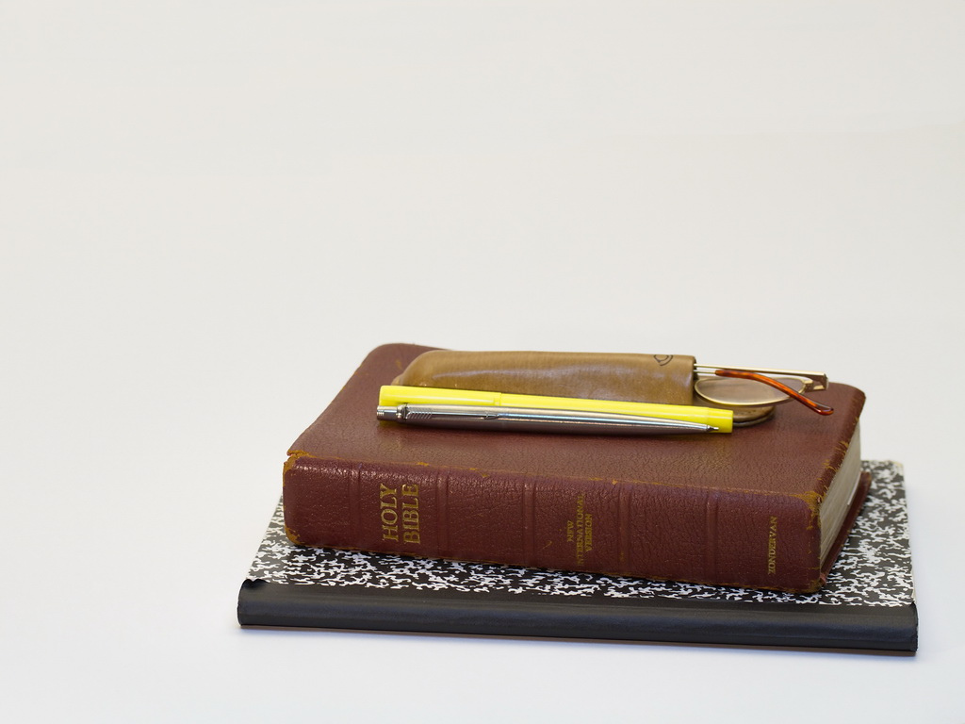
Biblical Stewardship
Much More Than Money

Slide 3
Everything Belongs To God
“The earth is the Lord’s” (1 Cor. 10:26)
We are accountable as stewards Luke 16:1-13
Biblical Stewardship
Much More Than Money

Slide 4
Steward of our ABILITIES
“each according to his own ability” (Matt. 25:15)
1 Corinthians 12:14-18
Biblical Stewardship
Much More Than Money

Slide 5
Steward of our TIME
Ephesians 5:15-16
Matthew 25:26
Biblical Stewardship
Much More Than Money

Slide 6
Steward of our WEALTH
Haggai 2:8
Deuteronomy 8:18
Warnings to the rich (Matt. 6:19-24; 1 Tim. 6:9-19; Luke 12:15-21)
Care for our own (1 Tim. 5:8)
Help those in need (Eph. 4:28’ Acts 4:35-37)
Giving to God (Gal. 6:5; Phil. 4:15-17; 1 Cor. 9:14; 2 Cor. 9:7; 1 Cor. 16:2)
Biblical Stewardship
Much More Than Money

Slide 7
Steward of our CHILDREN
A heritage from the Lord (Psalm 127:3)
We must teach.
We must warn and correct.
Respect for authority (man and God)
Love (seen and felt)
Responsibility
Biblical Stewardship
Much More Than Money

Slide 8
Steward of the GOSPEL
1 Corinthians 4:1-2
We must teach to next generation (2 Tim. 1:13-14; 2:2).
Preaching to the lost (Eph. 3:8)
Biblical Stewardship
Much More Than Money

Slide 9
Every steward must give account
Have we used our abilities?
Have we used our time?
Have we used our wealth?
Have we taught our children?
Have we shared the gospel?
Biblical Stewardship
Much More Than Money

