Slide 2
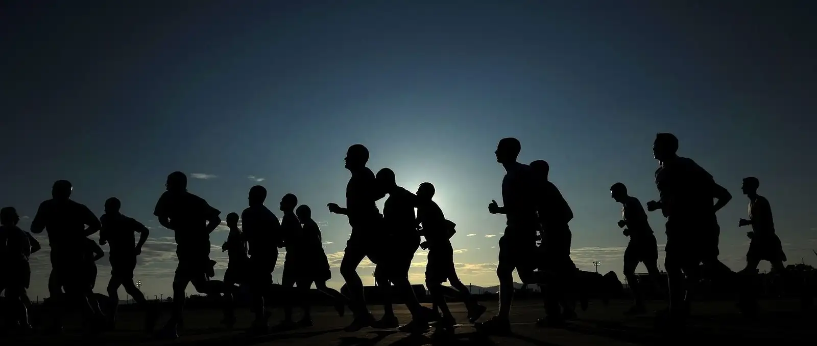
RUN TO WIN
1 Corinthians 9:24-27

Slide 3
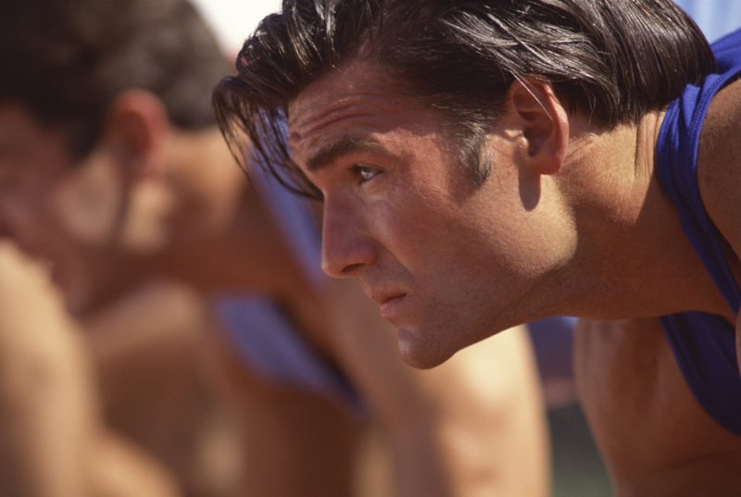
Get A Good Start
Some never enter the race
Long for the milk of the word (1 Peter 2:2)
Set Goals (1 Cor. 9:26) “not without aim”
> Determination to win
> Focus on the goal
> Desire to win

Slide 4
To Win: Stay In The Lane
Not disqualified (1 Cor. 9:27)
Discipline the body
The WILL is stronger than the body
Running by the rules

Slide 5
Keep A Steady Pace
Not a quick sprint.
With Endurance (Heb. 12:1)
Never Quit
1 Corinthians 15:58

Slide 6
Look Ahead To The Finish Line
Hebrews 12:1-2 “fixing our eyes on Jesus”
We run because of hope (1 Pet. 1:13)
Prevents us from being easily led into sin

Slide 7
Run Hard
Galatians 5:7
Philippians 2:14-16
Some run, but not to win.

Slide 8
Everyone Can Win!
A Good Start
Stay In Lane
Steady Pace
Eyes On Jesus
Run Hard
Have you begun the race?
Are you steadfast in running?

