Slide 2
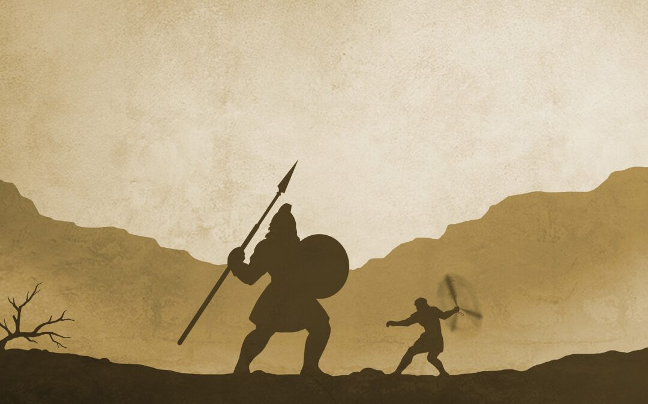
David & Goliath
1 Samuel 17:41-51

Slide 3
Goliath 9’6’’
Sahed 9’6’’
Wadlow 8’11’’
Willis 6’3’’

Slide 4
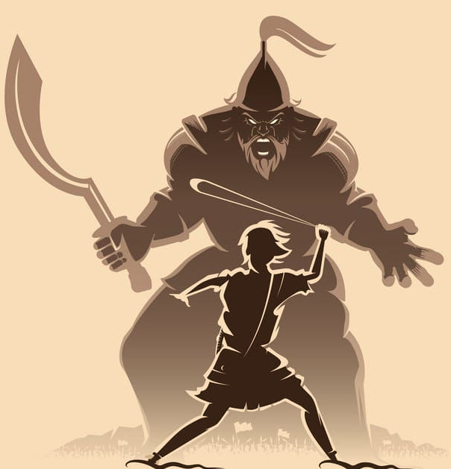
Seeing The World Differently
Seeing As Christ
John 4:17-18
Matthew 23:7
In Our Lives
Religious Solicitation
Arguing Brethren
Violation of God’s Will

Slide 5
Seeing The World Differently
David Spoke Up
1 Samuel 17:26; 36-37
Condemned By Others
David’s Brother (17:28-29)
We Must Speak
2 Corinthians 4:13

Slide 6
Seeing The World Differently
Moved To Action
1 Samuel 17:32
Trust In God
The Lion & The Bear
We Can Trust God
1 John 3:22; 5:14-15
We Must Fight The Battles

Slide 7
The Spirit Of David
Humility
Faith
Zeal For The Lord
Courage

Slide 8
Weapons Of War
David
The name of the Lord (17:45)
Colossians 3:17
Use The Familiar

Slide 9
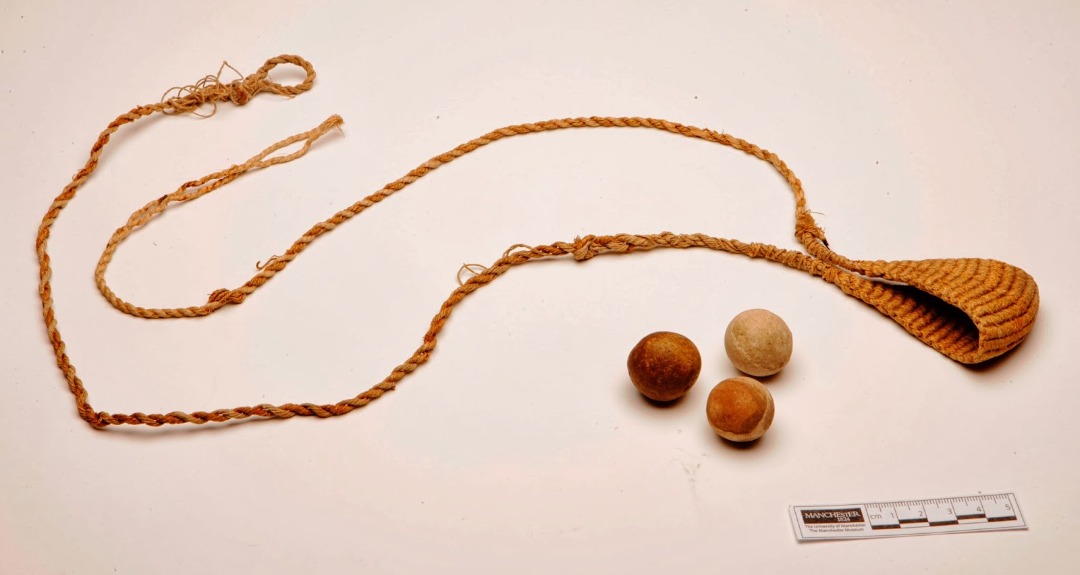
Weapons Of War
A Sling & Stones
Goliath’s Family
2 Samuel 21:22

Slide 10
Weapons Of War
Sword Of The Spirit
Ephesians 6:17
John 8:31-32
Reason/Persuade - Acts 19:8
Convince - James 5:19-20
Convict - Acts 2:37

Slide 11
Victory Is With God!
Over Goliath
Over Disbelievers
Over Blasphemer
Romans 8:31

Slide 12
Do you stand for the truth?
Is your trust in God?

