Slide 2
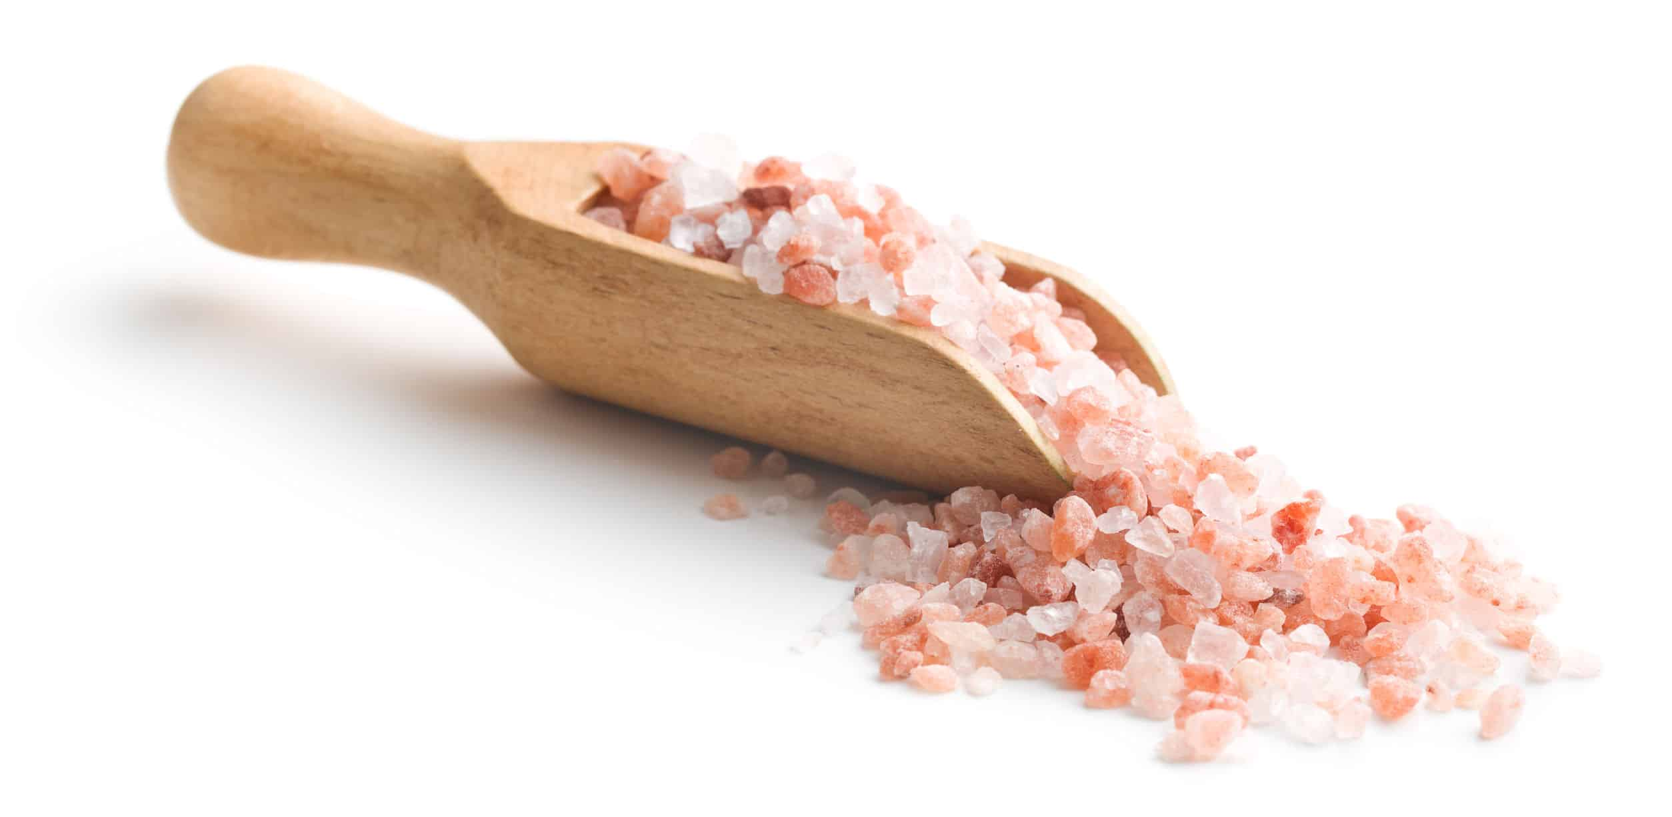
Tasteless Salt
Matthew 5:13

Slide 3
“You are the salt of the earth…”
Preserving
By Teaching
Acts 8:4
1 Corinthians 1:21
1 Timothy 3:15
Romans 10:14
By Influence
Philippians 1:27
Colossians 4:5
Titus 2:7-8
1 Peter 3:1-2
Matthew 5:16
Tasteless Salt

Slide 4
“You are the salt of the earth…”
Preserving
Causes Thirst
For Truth (1 Peter 3:15)
For Salvation (John 4:13-14)
Tasteless Salt

Slide 5
“You are the salt of the earth…”
Preserving
Causes Thirst
Irritates Wounds
Jesus’ Example
(Luke 17:25; 23:18; John 5:43; Matthew 26)
Matthew 5:11-12
Tasteless Salt

Slide 6
“You are the salt of the earth…”
Preserving
Causes Thirst
Irritates Wounds
A Contrast Between World & Christians
1 Corinthians 6:14-18; John 17:27; 2 Timothy 3:12
Tasteless Salt

Slide 7
“If the salt has become tasteless…”
Matthew 5:13; Mark 9:50
Deteriorate
(Hebrews 2:1; Revelation 2:4-5; Hebrews 5:12;
James 5:19; Hebrews 12:3)
Tasteless Salt

Slide 8
“If the salt has become tasteless…”
Matthew 5:13; Mark 9:50
Deteriorate
Become Indifferent
Tasteless Salt

Slide 9
“If the salt has become tasteless…”
Matthew 5:13; Mark 9:50
Deteriorate
Become Indifferent
“No longer good for anything…”
(1 Peter 2:21-22; Hebrews 10:26-31;
Matthew 13:40-43)
Tasteless Salt

Slide 10
Maintain Saltiness
Romans 12:1-2
Romans 6:12-13
1 Timothy 6:14
Salt Works On Contact!
Hebrews 10:36-39
Tasteless Salt

Slide 11
Does this describe you?
Repent of Sin
To become righteous Jesus said:
Believe (John 8:24)
Repent (Luke 13:3)
Confess Him (Matthew 10:32)
Be Baptized (Matthew 28:19-20)
Tasteless Salt

