Slide 2
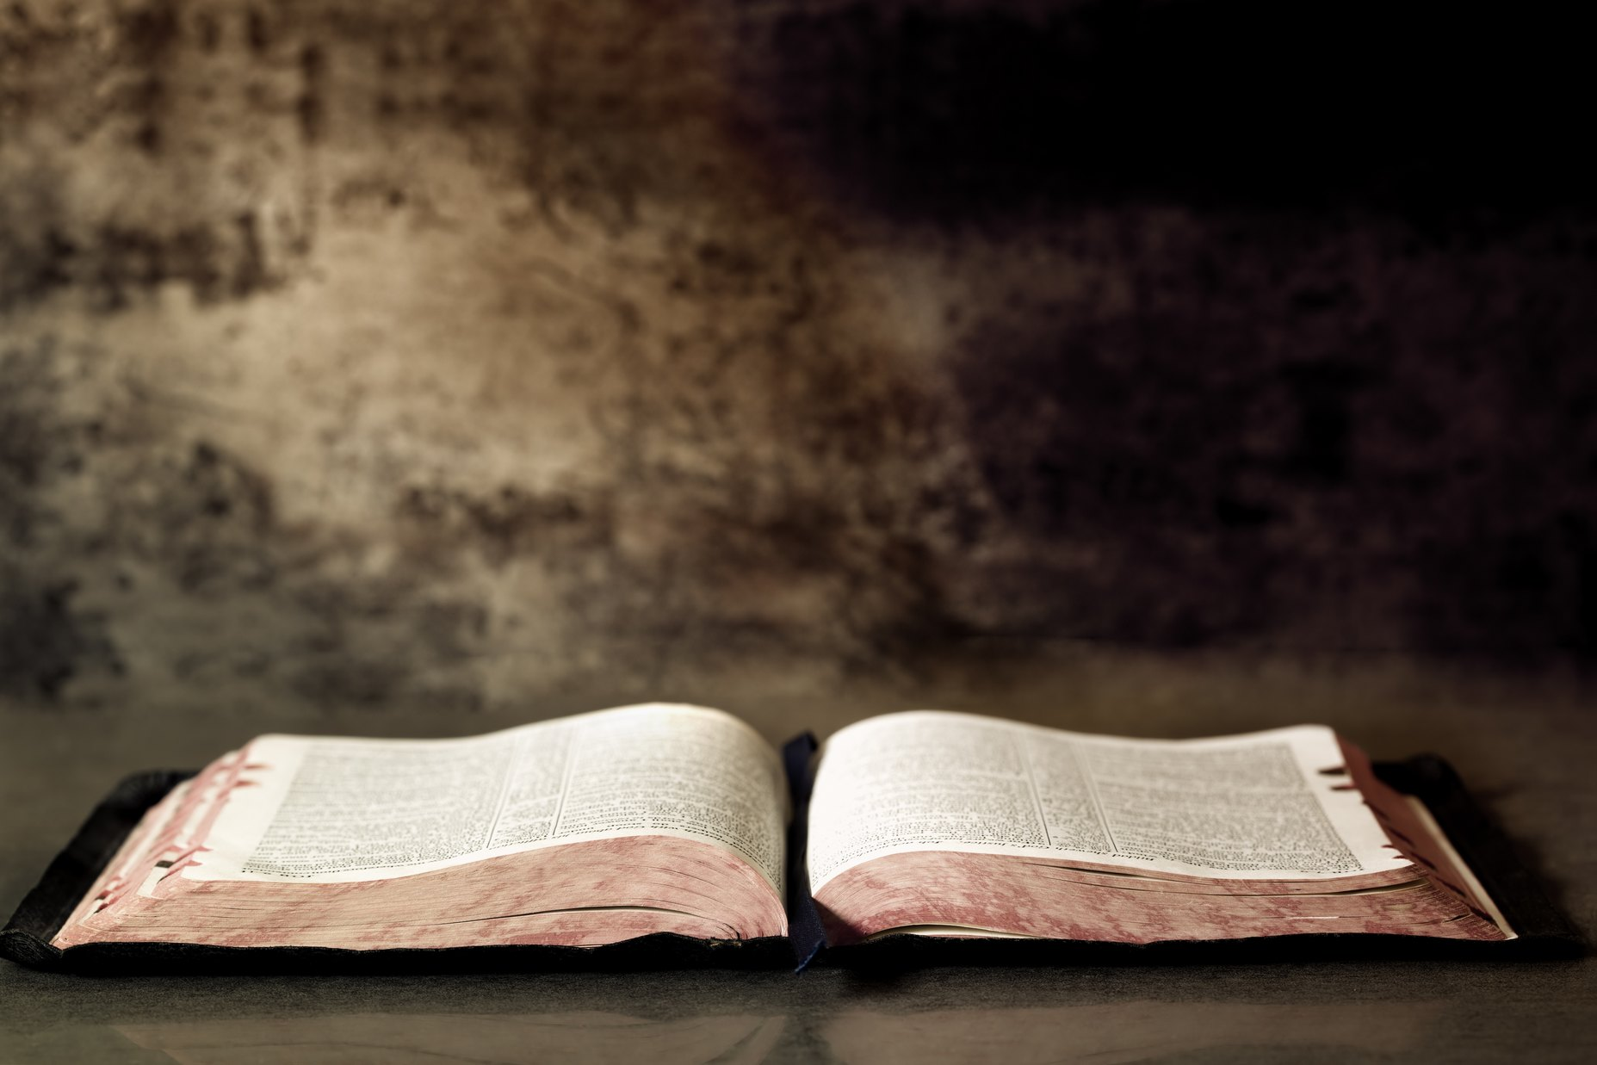
The Problem Of Illiteracy
Psalm 119:9-16

Slide 3
Effect On Individuals
Destroyed (Hosea 4:1, 6; Is. 59:2)
People Faint (Amos 8:11-13; Acts 3:17)
No Direction (Psalm 119:105)
No Joy or Peace (Psalm 119:111, 165; Phil. 4:7)

Slide 4
Effect On Congregations
No Teachers (Heb. 5:12)
Easily Led Astray (2 Peter 2:1-3)

Slide 5
Effect On Community
Good is evil, and evil is good (Is. 5:20)
Proverb 14:34

Slide 6
Antidote To Biblical Illiteracy
Daily Bible Reading In Private
Frequent In-Depth Bible Study With Others
Parents Accepting God Given Responsibility

