Slide 1
Surviving The Storm
1 Peter 1:3-9

Slide 2
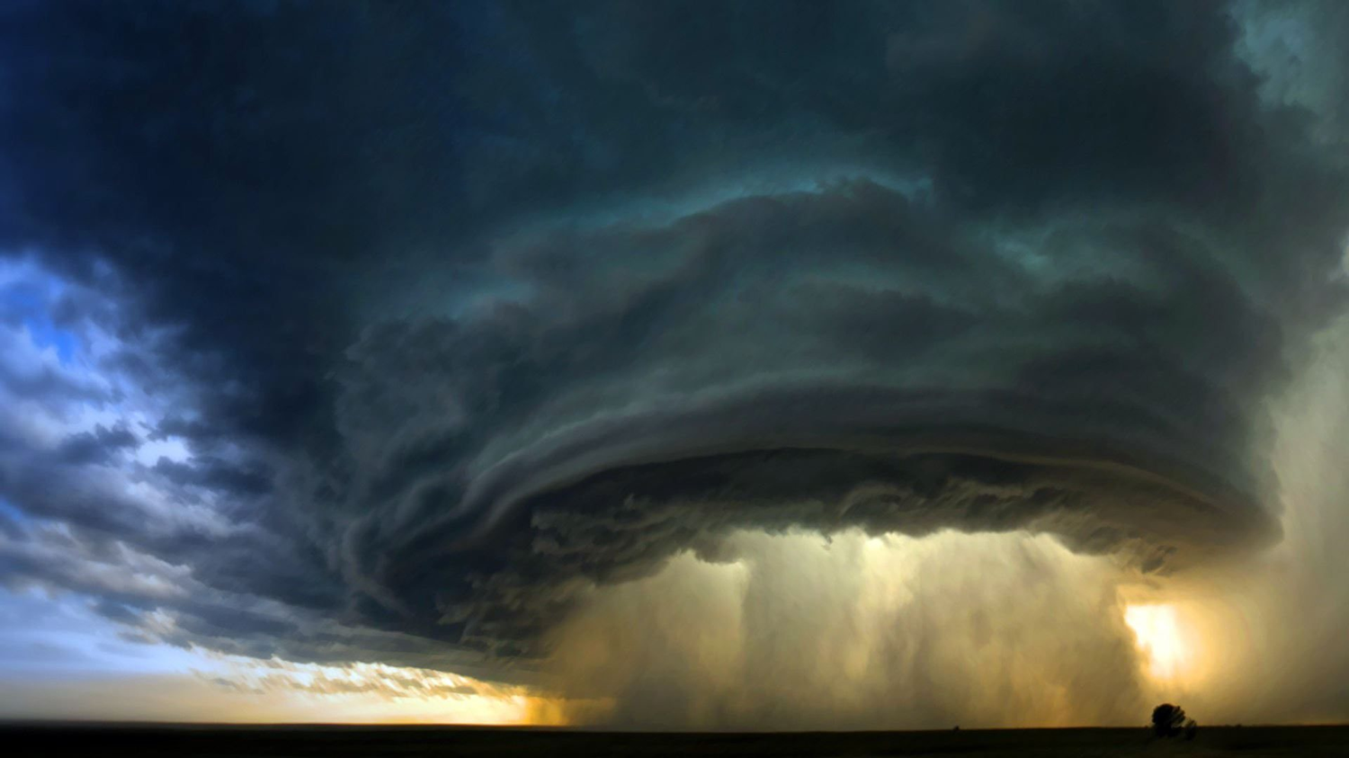
surviving the storm
1 PETER 1:3-9

Slide 3
lessons from real storms
The Great Flood (Genesis 6)
The Hurricane (Acts 27)
The Sea Of Galilee (Mark 4)

Slide 4
MATTHEW 7:24-27
Acting On Jesus’ Words
Matthew 6:1
Matthew 6:19-21
Matthew 6:31-34
Mark 4:16-17
Principle seen in:
Matt. 6:21; Rom. 2:13; James 1:22

Slide 5
Ephesians 4:14-15
How do we overcome this?
Ephesians 4:13
We need maturity
We need knowledge of Jesus

Slide 6
HOW ARE YOU HANDLING THE STORMS OF LIFE?
COME TO THE ROCK!

