Slide 1
Overcoming
John 16:33

Slide 2
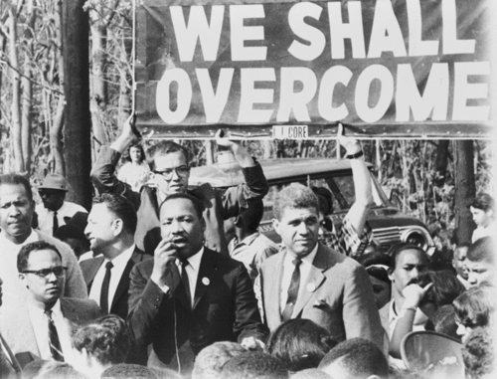
English:
(1) To defeat
(2) To gain control of
(3) To affect
Greek is “nikao”:
(Strong’s) To subdue
(Thayer) To conquer…carry off the victory
OVERCOMING
John 16:33

Slide 3
Jesus Overcame The World
We live in two states (John 16:33):
“In Him” and “In the world”
Jesus was the man of sorrows:
Physical sorrows
Burdens He bore (1 John 2:2)
The center of attack (Heb. 4:15; Matt 4)
Jesus overcame Satan (Heb. 2:14-15)
OVERCOMING

Slide 4
We Are To Overcome The World
“Take courage” (John 16:33)
1 John 4:4 “…greater is He who is in you…”
1 John 5:4-5 “…this is the victory…”
Romans 12:21 “…overcome evil with good”
(2 Pet. 2:19-20; Rom. 6:16)
1 John 2:14 “…you have overcome the evil one”
OVERCOMING

Slide 5
Blessings To Those Who Overcome
Rev. 2:7 “…tree of life…”
Rev. 2:11 “…not hurt by the second death”
Rev. 2:17 “…a white stone…”
Rev. 2:26-28 “…the morning star…”
Rev. 3:5 “…I will confess his name…”
Rev. 3:12 “…I will write on him…”
Rev. 3:21 “…sit down with Me on My throne…”
Rev. 21:7 “…he will be My son…”
OVERCOMING

Slide 6
OVERCOMING
Jesus Overcame The World
We Are To Overcome The World
Blessings Promised To Those Who Overcome
Will Jesus say
YOU have overcome?

