Slide 1
Fishers Of Men
Matthew 4:18-22

Slide 2
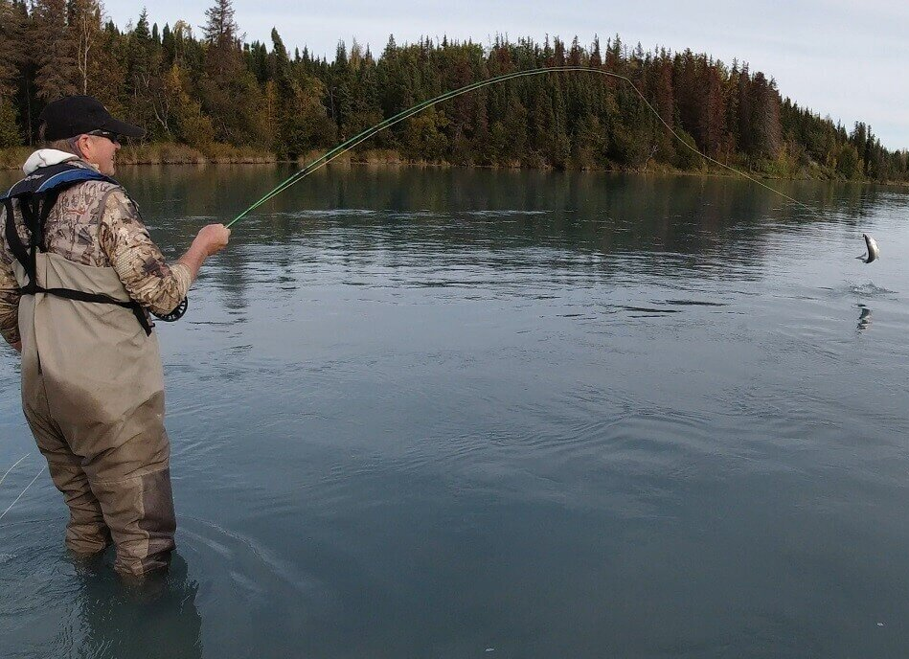
Fishers
Men
of
Matthew 4:18-22

Slide 3
Follow Me
Leave Others
They Would Belong To Him
They Would Teach What He Taught
(Matt. 28:20; 1 Cor. 11:23; Gal. 1:11-12)
Fishers of Men

Slide 4
I Will Make You
We Are Undergoing Training
(Col. 3:12-15; 2 Pet. 1:5-10)
For Use In The Kingdom
(Matt. 24:14-15; 1 Cor. 12:18; 1 Tim. 4:14)
Hebrews 6:9-12
Luke 6:40 “Everyone, after he
has been fully trained, will be
like his teacher.”
Fishers of Men

Slide 5
Fishers of Men
A Changed Purpose (Col. 3:2; Matt. 6:33)
Diligence (Rom. 12:11; Heb. 6:11)
Hard Working (James 2:20; Luke 10:2)
Daring (2 Tim. 4:1-5; Matt. 10:16-18)
Knowledgeable (1 Cor. 9:19-23)
Successful (1 Thess. 1:8)
Fishers of Men

Slide 6
Follow Me, and I will make you
Fishers
Men
of
How well have you molded yourself to His training?

